Slide 1
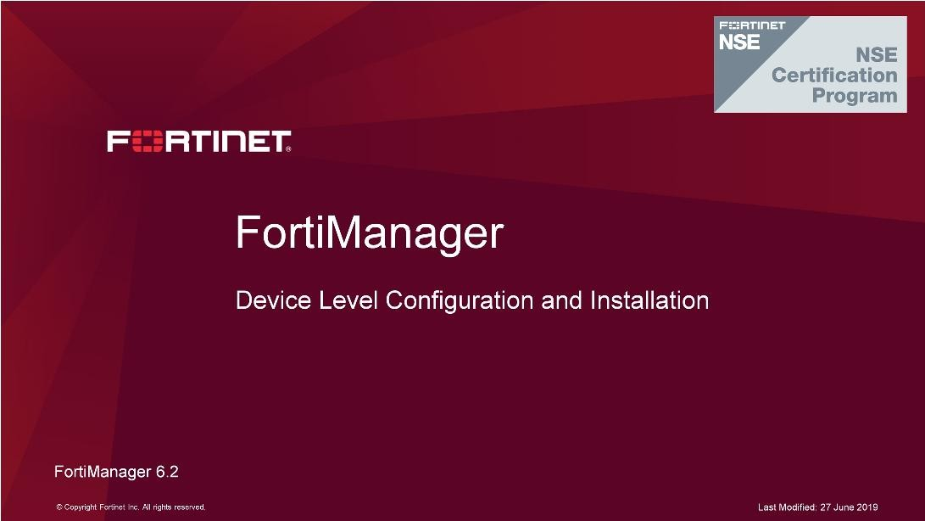
DO NOT REPRINT
© FORTINET
Device Level Configuration and Installation
In this lesson, you will learn how to configure device-level changes, understand the status of a managed FortiGate on FortiManager, and install changes to the managed FortiGates. You will also learn how to use the revision history for troubleshooting, and you will learn about the capabilities of scripts and device groups.

Slide 2
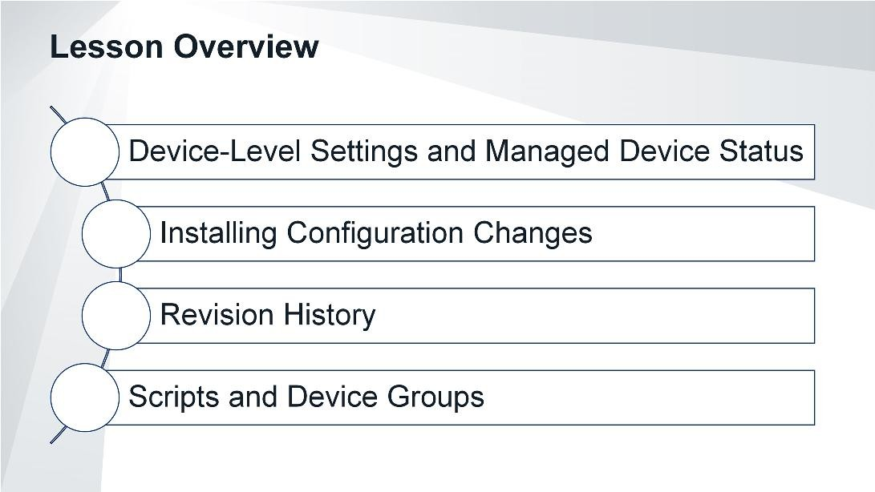
DO NOT REPRINT
© FORTINET
Device Level Configuration and Installation
In this lesson, you will explore the topics shown on this slide.

Slide 3
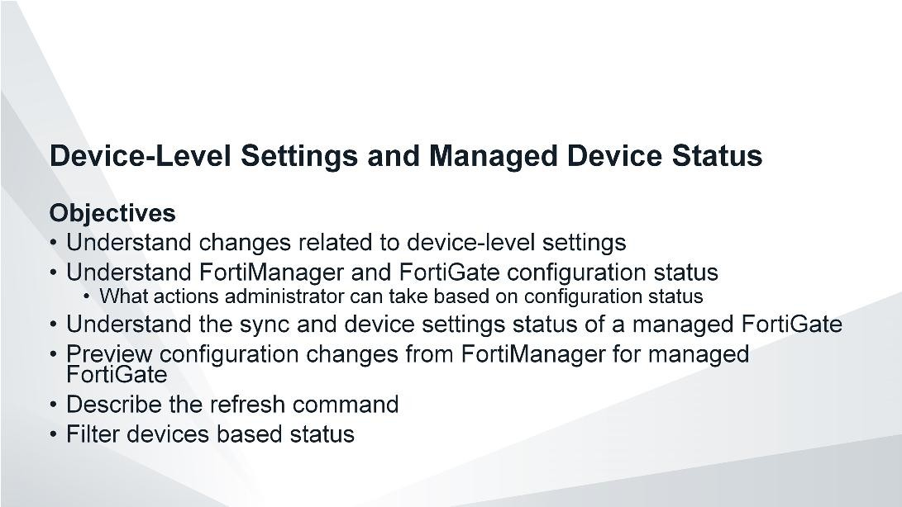
DO NOT REPRINT
© FORTINET
Device Level Configuration and Installation
After completing this section, you should be able to achieve the objectives shown on this slide.
By demonstrating competence in understanding FortiGate configuration status and synchronization behavior, you will be able to diagnose and take actions based on the status of FortiGate.

Slide 4
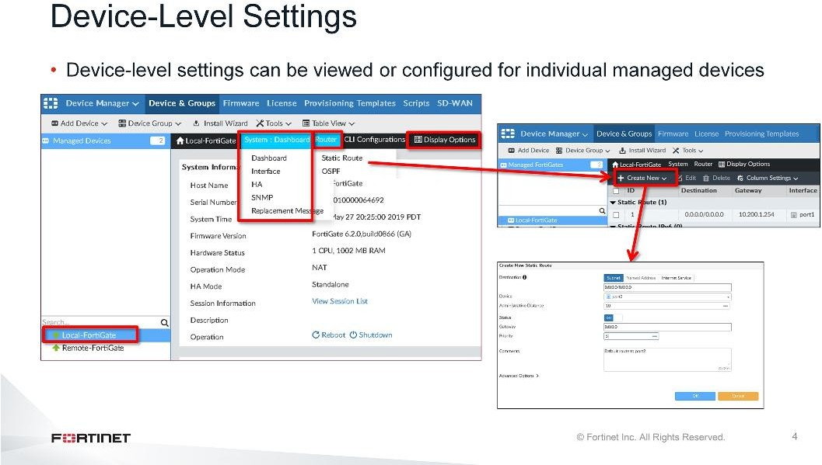
DO NOT REPRINT
© FORTINET
Device Level Configuration and Installation
To configure registered devices, select the device or VDOM in the Device Manager. In this example, the FortiGate device named Local-FortiGate is selected.
The device-level settings of a managed FortiGate can be viewed and configured from the toolbar at the top of the Dashboard allows to view or configure interfaces, HA, DNS, to name a few. To configure or view routes select the Router tab.
In this example, a new static route is created.
Most of the settings that you see in this example have a one-to-one correlation with the device configuration that you would see if you logged in locally using the FortiGate GUI or CLI.
Note that there are only a few options in the toolbar (Dashboard and Router). You can click Display Options to customize device tabs at the device level.

Slide 5
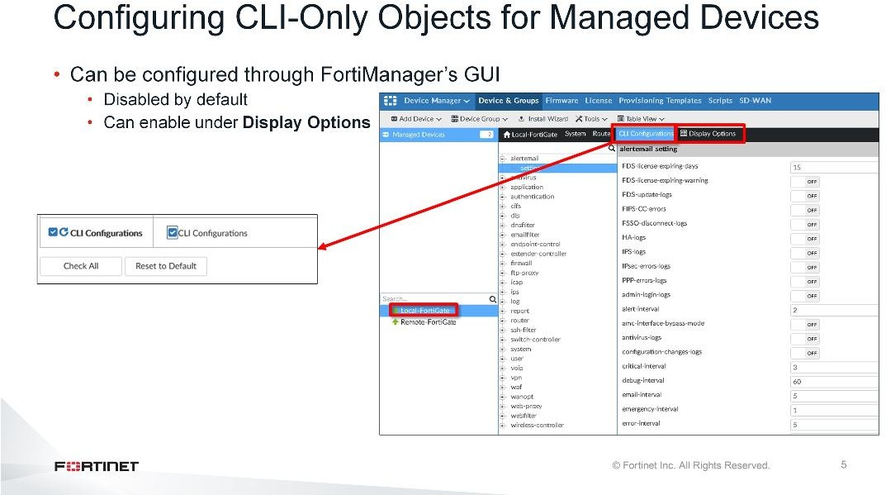
DO NOT REPRINT
© FORTINET
Device Level Configuration and Installation
The CLI-Only Objects menu allows you to configure device settings that are normally available and configured only through FortiGate’s CLI.
Note that the available options vary according to device, supported features, and firmware version. Hidden by default, this menu can be enabled in Display Options.
The CLI-Only Objects menu is available in the Device Manager and Policy & Objects panes.

Slide 6
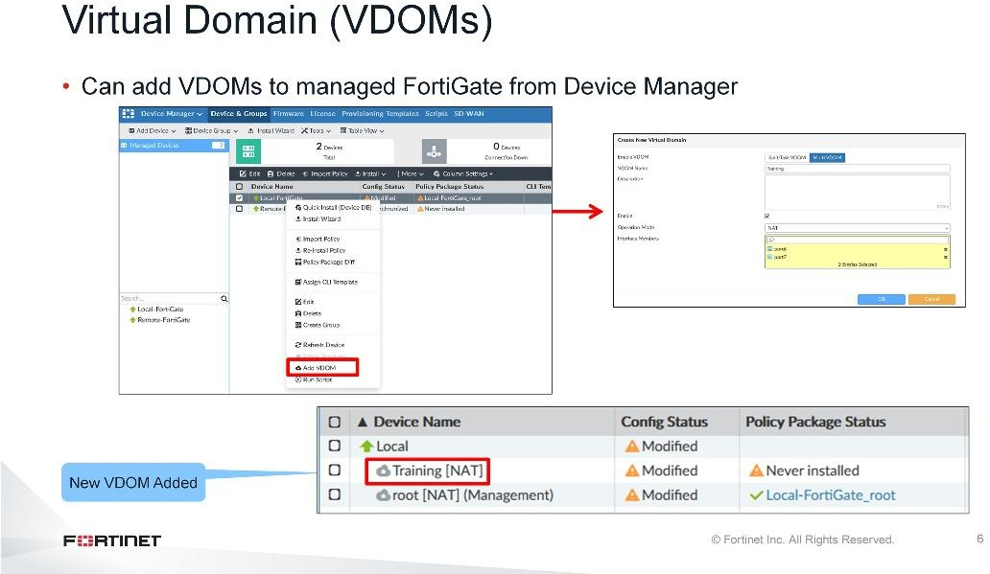
DO NOT REPRINT
© FORTINET
Device Level Configuration and Installation
You can add a VDOM to the managed device from the Device Manager pane. Adding a VDOM is a configuration change, so you need to install these changes on the managed device.

Slide 7
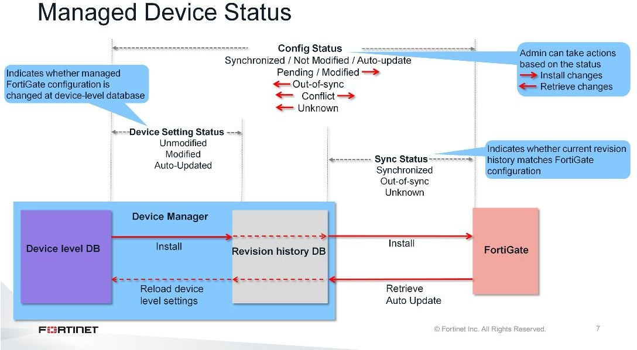
DO NOT REPRINT
© FORTINET
Device Level Configuration and Installation
This diagram shows the status of a managed FortiGate. FortiManager keeps FortiGate configurations in the revision history. The latest revision history is compared with the FortiGate configuration to provide the sync statuses. The latest revision history is also compared with the device-level database (device setting status) of the FortiGate, which indicates if FortiGate configuration has changed on the FortiManager.
Knowing the overall configuration status of a managed device helps the administrator identify issues and take appropriate actions from FortiManager:
Synchronized / Not modified / Auto-Update: The latest revision history configuration entry (whether an install, retrieve, or auto-update) is aligned with the configuration on FortiGate.
Pending / Modified: The FortiGate configuration different from FortiManager and is pending an install operation in order to return to an unmodified state. The install operation will create new revision history.
Out-of-sync: The latest revision history configuration entry does not match the configuration on the FortiGate due to configuration changes made locally on FortiGate, or a previous partial install failure. It is recommended that you perform a retrieve from the FortiManager.
Conflict: If the changes are made locally on the FortiGate and are not retrieved, but changes are also made from FortiManager, the status goes in conflict state. Depending on the configuration changes, you
can either retrieve the configuration or install the changes from FortiManager.
Unknown: The FortiManager is unable to determine the synchronization status because the FortiGate is not reachable, or due to a partial install failure. It is recommended that you perform a retrieve from the FortiManager.

Slide 8
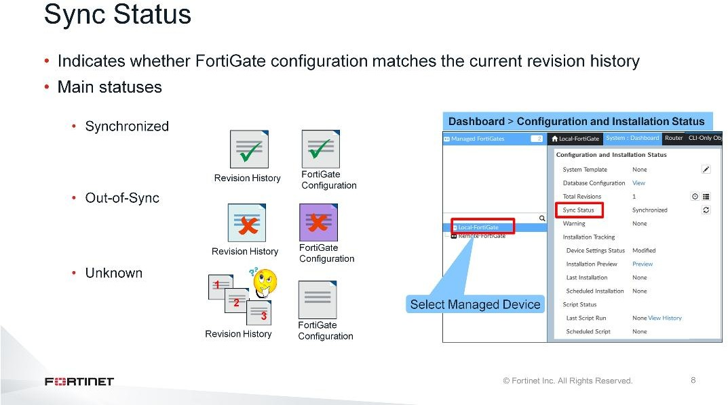
DO NOT REPRINT
© FORTINET
Device Level Configuration and Installation
On the Device Manager pane, click a managed FortiGate to select it and view its dashboard. You can see the
Sync Status field under the Configuration and Installation Status widget.
The Sync Status compares the running device configuration with the current version in the revision history. There are three possible sync statuses:
Synchronized: The current revision history configuration entry (whether an install or retrieve) is synchronized with the running configuration on the FortiGate.
Out-of-sync: The current revision history configuration entry does not match the running configuration on the FortiGate. It can be caused by failed installation or direct changes made on FortiGate which were not auto updated.
Unknown: The FortiManager system is unable to detect which revision (in the revision history) is currently
running on the device.

Slide 9
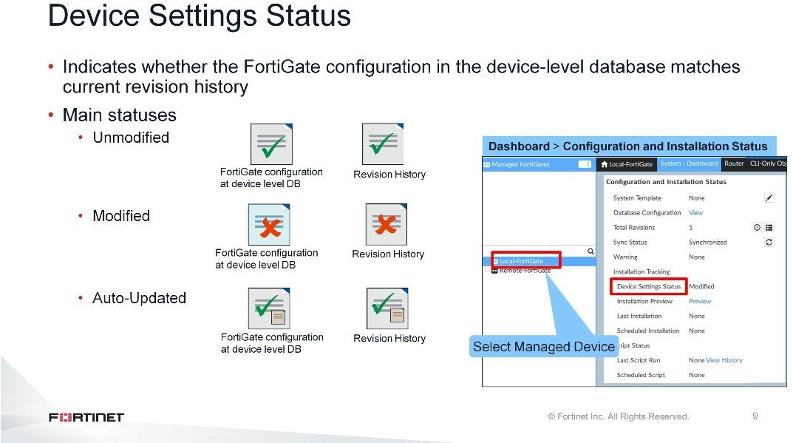
DO NOT REPRINT
© FORTINET
Device Level Configuration and Installation
The Device Settings Status field can be found under the Configuration and Installation Status widget. The Device Settings Status indicates the status of the device settings on the FortiManager. There are three device setting statuses:
Unmodified: The FortiGate configuration in the device-level database is in sync with the current revision in the revision history. This means that there are no changes to the device database and nothing to install.
Modified: If the device is configured from the Device Manager, the device database is changed and the device settings status is tagged as Modified, because it doesn’t match the revision history for that device. If changes are installed, it puts the device back into the unmodified state.
Auto-Updated: The configuration changes are made directly on the FortiGate and have automatically updated the device database.

Slide 10
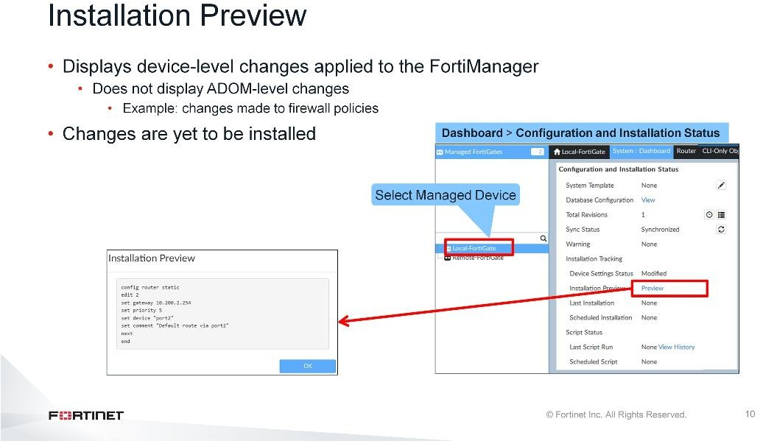
DO NOT REPRINT
© FORTINET
Device Level Configuration and Installation
Under the Configuration and Installation Status widget, click Preview to view the changes made to the device database on FortiManager. These are the exact commands that will be installed on this FortiGate when next install is performed.
Previously, we configured a new static route. That is why the Device Settings Status is tagged as Modified. In this example, the static route configuration will be pushed to FortiGate on the next install.

Slide 11
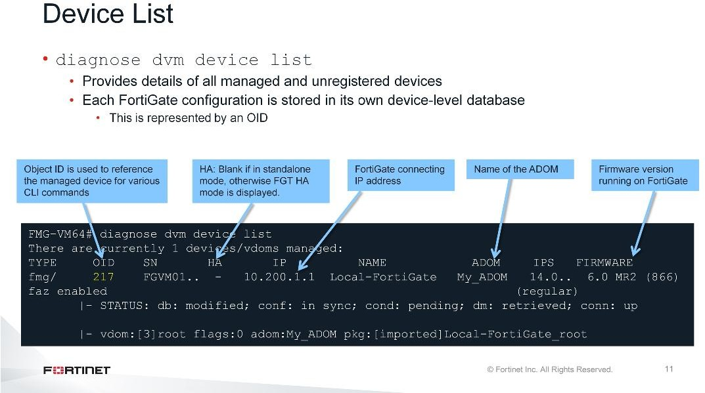
DO NOT REPRINT
© FORTINET
Device Level Configuration and Installation
The diagnose dvm device list command provides the list of all devices or VDOMs for managed and unregistered devices. It also provides information, such as serial number, connecting IP, firmware, HA mode, and statuses for device-level and policy package.

Slide 12
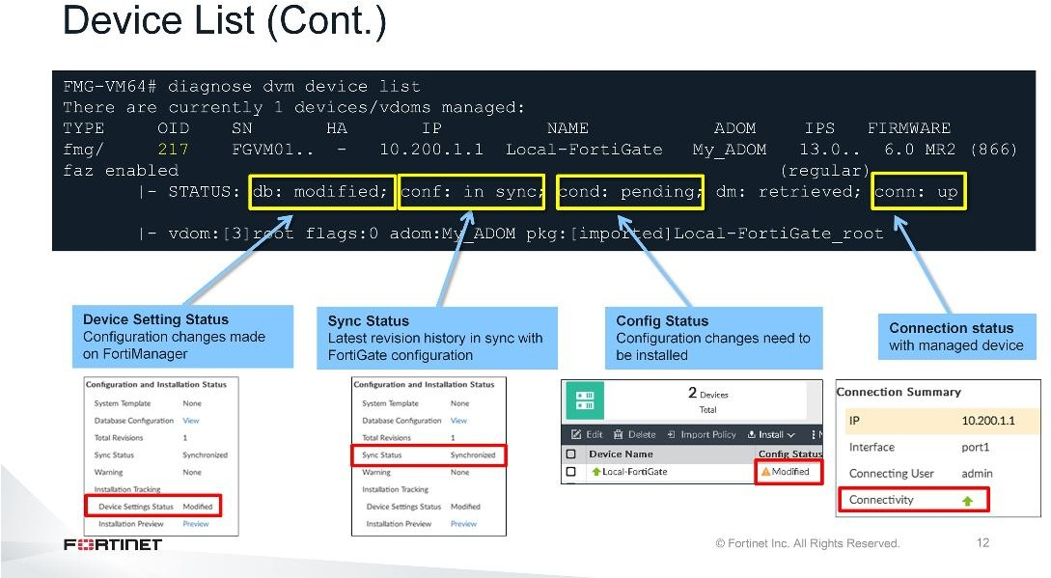
DO NOT REPRINT
© FORTINET
Device Level Configuration and Installation
This example shows that FortiGate configuration is in sync with the latest running revision history. However, changes have been made to device-level settings. That is why the CLI output is showing db:modified and the cond is showing as pending. Once the changes are installed on FortiGate, it will show db:unmodified and cond:OK.
You can also check whether the FGFM tunnel between FortiGate and FortiManager is up or down.

Slide 13
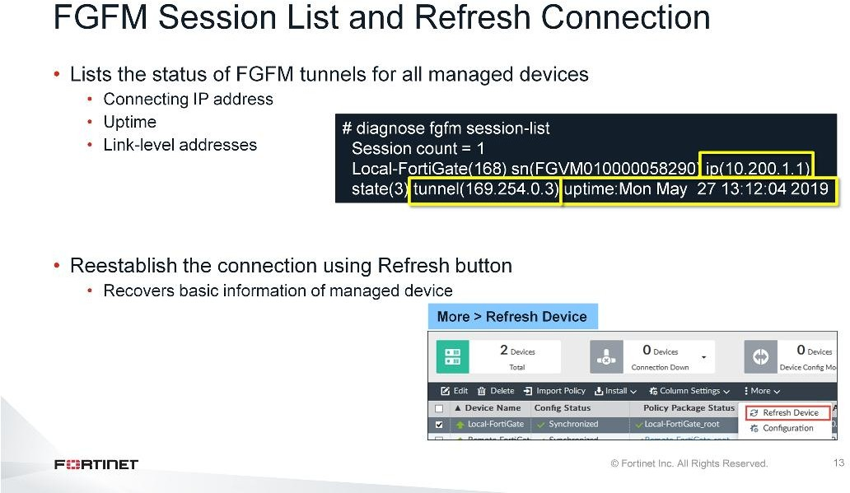
DO NOT REPRINT
© FORTINET
Device Level Configuration and Installation
You can use the diagnose fgfm session-list command to verify the FGFM tunnel uptime between FortiManager and FortiGate devices, display the connecting IP addresses of all managed devices, and show the link-level addresses assigned by FortiManager to FortiGate devices for management traffic.
When you refresh a device you attempt to establish the connection between the selected device and FortiManager. This operation retrieves basic information about the managed device, such as serial number, firmware version, support contracts, and FortiGate HA cluster member information.
You can refresh the connection by clicking the Refresh icon in the Connection Summary widget, or by selecting the device in the Device Manager and then selecting Refresh Device from the More drop-down menu.

Slide 14
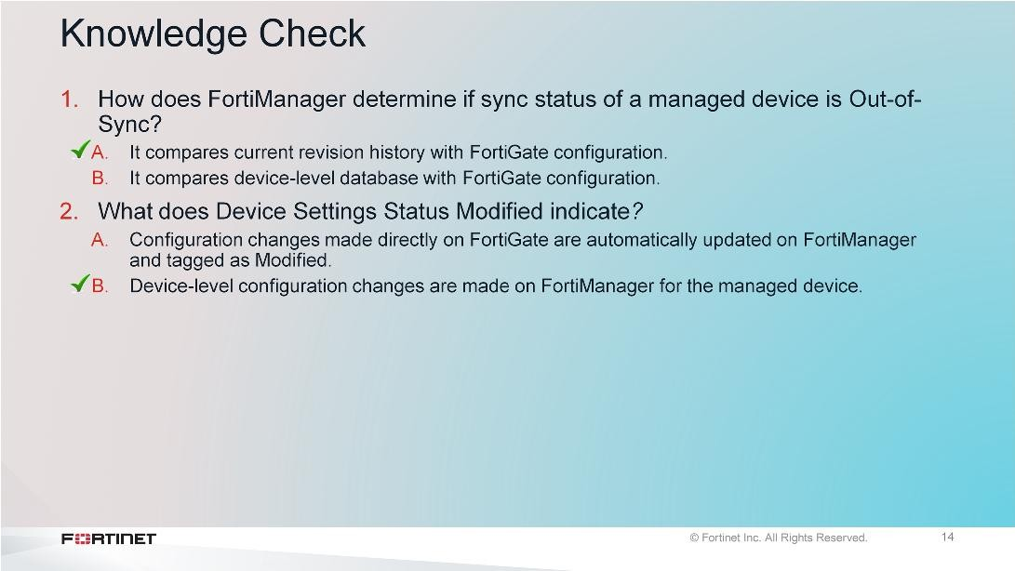
DO NOT REPRINT
© FORTINET
Device Level Configuration and Installation

Slide 15
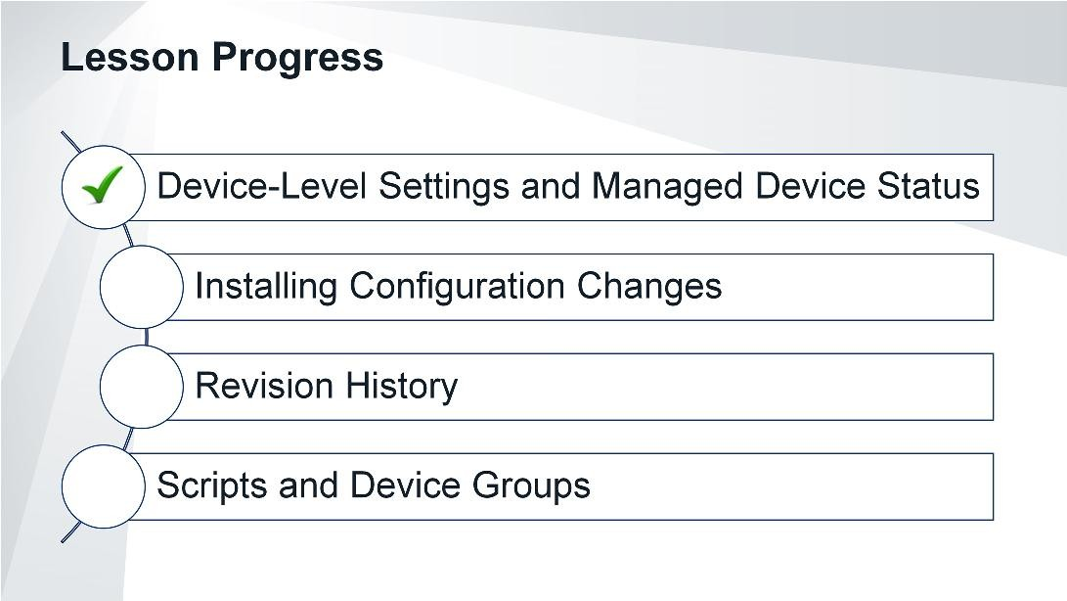
DO NOT REPRINT
© FORTINET
Device Level Configuration and Installation
Good job! You now understand the device-level settings and status of the managed device on FortiManager.
Now, you will learn how to install configuration changes from the FortiManager.

Slide 16
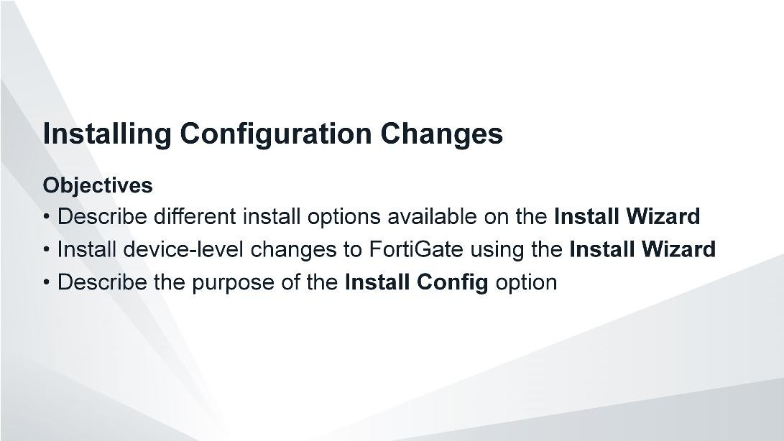
DO NOT REPRINT
© FORTINET
Device Level Configuration and Installation
After completing this section, you should be able to achieve the objectives shown on this slide.
By demonstrating competence in installing configuration changes, you will successfully make changes to managed devices through the FortiManager.

Slide 17
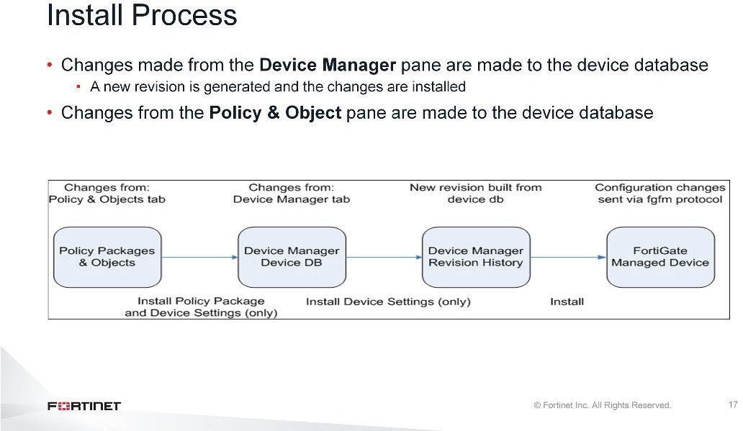
DO NOT REPRINT
© FORTINET
Device Level Configuration and Installation
This diagram illustrates the installation process that pushes changes from the Device Manager pane to a device. For completeness, the Policy & Objects pane is also included in this illustration.
When a new configuration is installed, FortiManager compares the latest revision history running on the device with the changes made on FortiManager. FortiManager then creates a new revision in the revision history and installs these changes on the managed device.

Slide 18
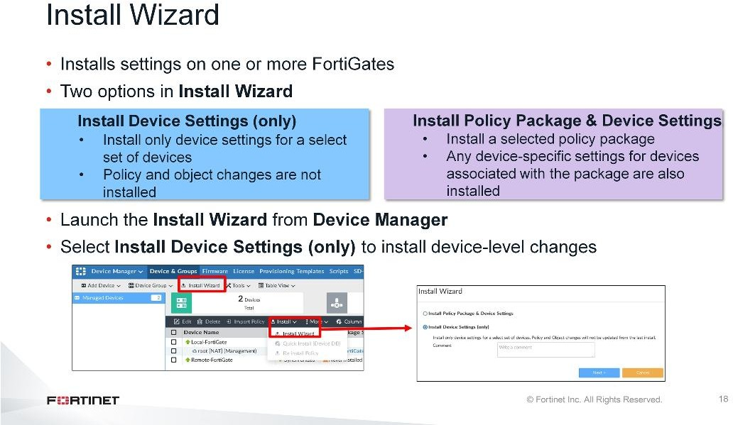
DO NOT REPRINT
© FORTINET
Device Level Configuration and Installation
The installation process involves FortiManager’s Install Wizard. Configuration changes made from the Device Manager do not take immediate effect—they have to be installed. Until they are installed, the Device Setting Status remains as Modified.
During installation, you are asked to choose between two different installation types.
If you choose Install Device Settings (only), the wizard will install only device-level configuration changes made from FortiManager. If you have made changes to the device-level configuration and policies in the policy packages, you can choose Install Policy Package & Device Settings, which will install policy package changes and any device-specific settings.
To launch the install wizard, click Install Wizard on the toolbar, or click Install and choose Install Wizard.
When the Install Wizard opens, you need to choose which option you want to use to install your settings. In this example, we select Install Device Settings (only). This option installs only the configuration changes that are related to device-level settings. Because we previously added a new route to the managed FortiGate, the Config Status is showing as Modified. During this installation process, the device configuration items are installed on the managed device. Once complete, the FortiManager and FortiGate are in sync, and the Config Status changes from Modified to Synchronized.

Slide 19
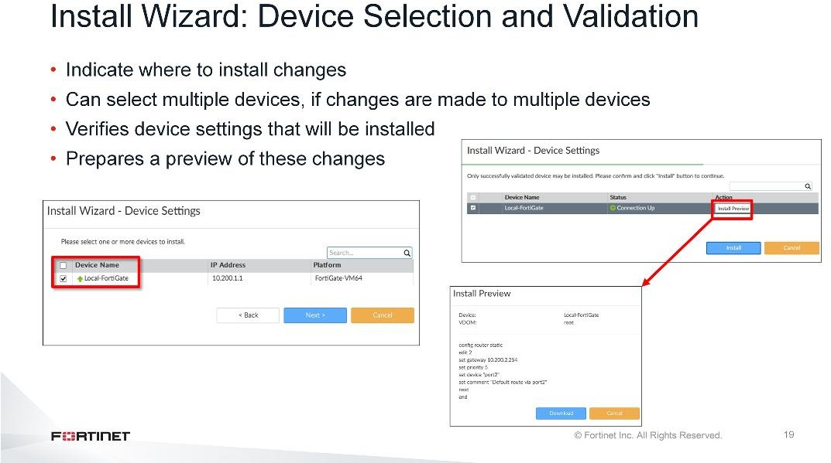
DO NOT REPRINT
© FORTINET
Device Level Configuration and Installation
In the next step, you need to select the device on which you want to install the changes. If you’ve made device-level changes to multiple devices under the Device Manager, you can select multiple devices on which to install those changes.
The next step is validation. The Install Wizard checks the device settings and compares them with the latest running revision history.
Click Preview to view the configuration changes that will be installed on the managed FortiGate. You can download the preview by clicking Download. The file is saved in a .txt format.
As a best practice, you should always preview and verify the changes that will be committed to FortiGate. In the case of a conflict, you can cancel the installation. Then, you can review and correct the conflicting configuration under Device Manager and relaunch the Install Wizard.
In this example, a new static route has been added.

Slide 20
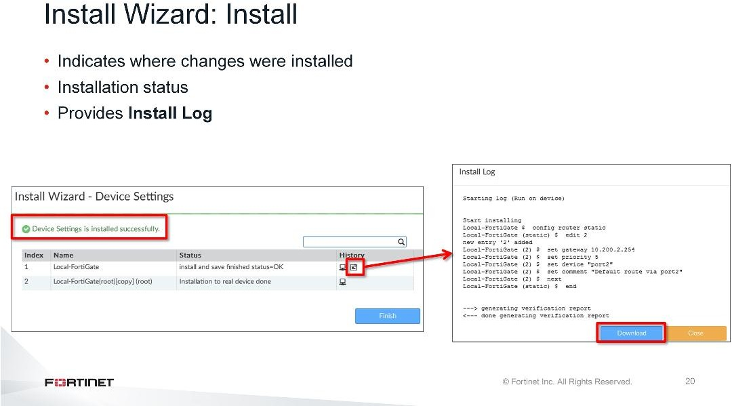
DO NOT REPRINT
© FORTINET
Device Level Configuration and Installation
The final step performed in the Install Wizard is the installation. After the installation is complete, you can view the Install Log to see the list of the devices on which the configuration changes were installed.
The log also shows any errors or warnings that occurred during the install process. Click Install Log to view the configuration changes installed on the managed FortiGate. If the installation fails, the install log provides an indication of the stage where the failure occurred.
In this example, the installation was successful and FortiManager created a new revision history for the install.

Slide 21
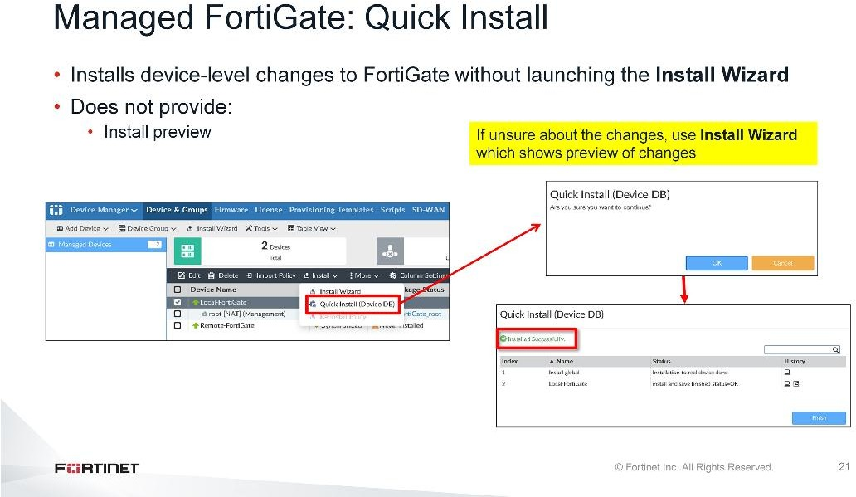
DO NOT REPRINT
© FORTINET
Device Level Configuration and Installation
The Quick Install option allows you to perform a quick installation of device-level settings without launching the Install Wizard. When you use this option, you cannot preview the changes prior to committing.
Administrators should be certain of the changes before using this install option, because the install can’t be cancelled after the process is initiated.
If unsure about the changes, administrators are encouraged to use the Install Wizard, so that they can preview the changes before committing.

Slide 22
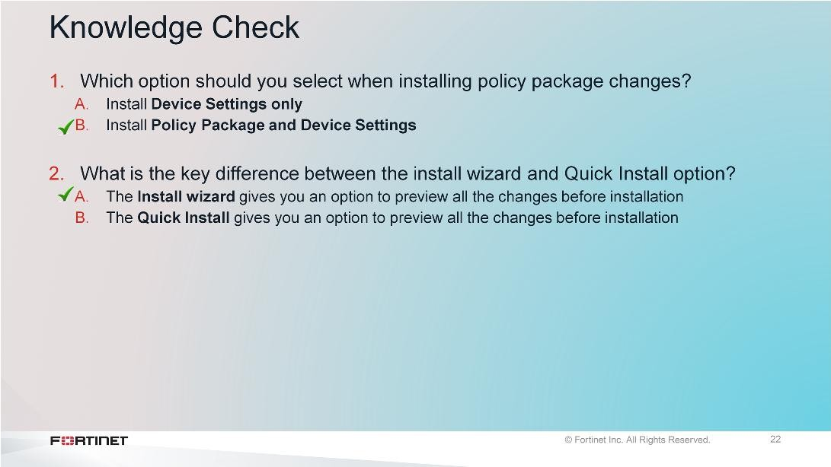
DO NOT REPRINT
© FORTINET
Device Level Configuration and Installation

Slide 23
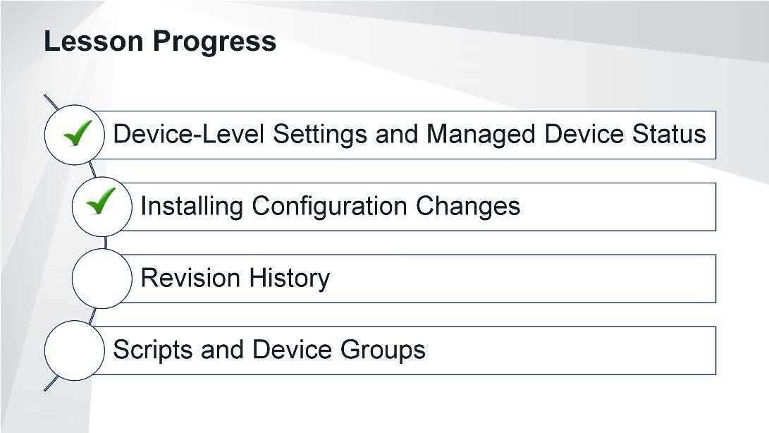
DO NOT REPRINT
© FORTINET
Device Level Configuration and Installation
Good job! You now understand the steps involved in installing device-level configuration changes.
Now, you will learn about the revision history repository for the managed FortiGate on the FortiManager.

Slide 24
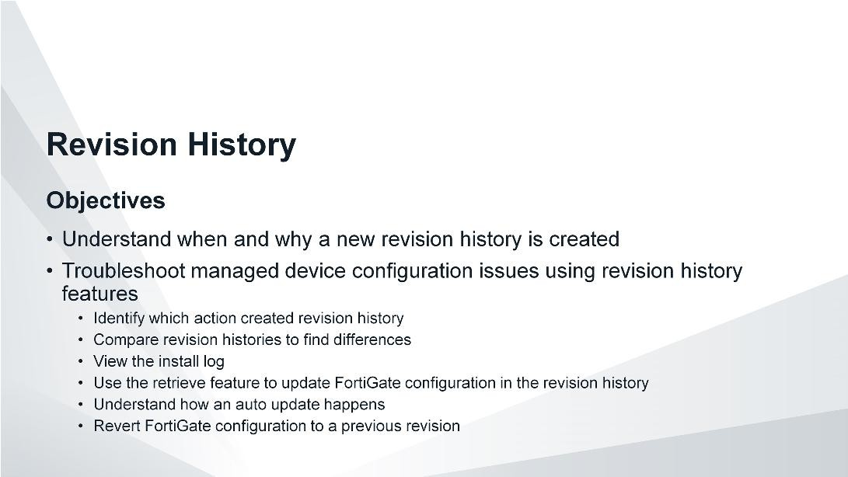
DO NOT REPRINT
© FORTINET
Device Level Configuration and Installation
After completing this section, you should be able to achieve the objectives shown on this slide.
By demonstrating competence in using revision history features, you will be able to diagnose and troubleshoot common issues related to FortiGate configuration changes.

Slide 25
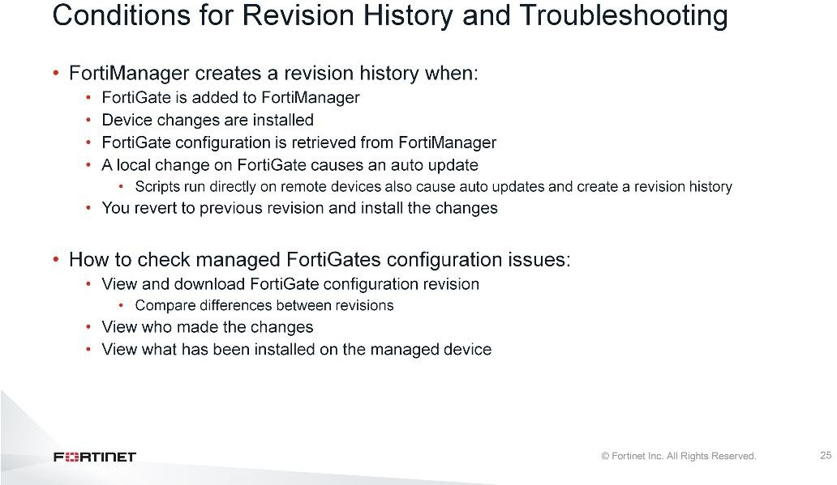
DO NOT REPRINT
© FORTINET
Device Level Configuration and Installation
A revision history is created by many different operations, such as adding a device, installing changes, retrieving a configuration, or the occurrence of an auto-update.
FortiManager maintains a repository of the configuration revisions made to managed devices.
This allows the FortiManager administrator to view and download the configuration revisions for a managed device, inspect configuration changes between configuration revisions, view installation history, and view which administrator or process created the new configuration revision.

Slide 26
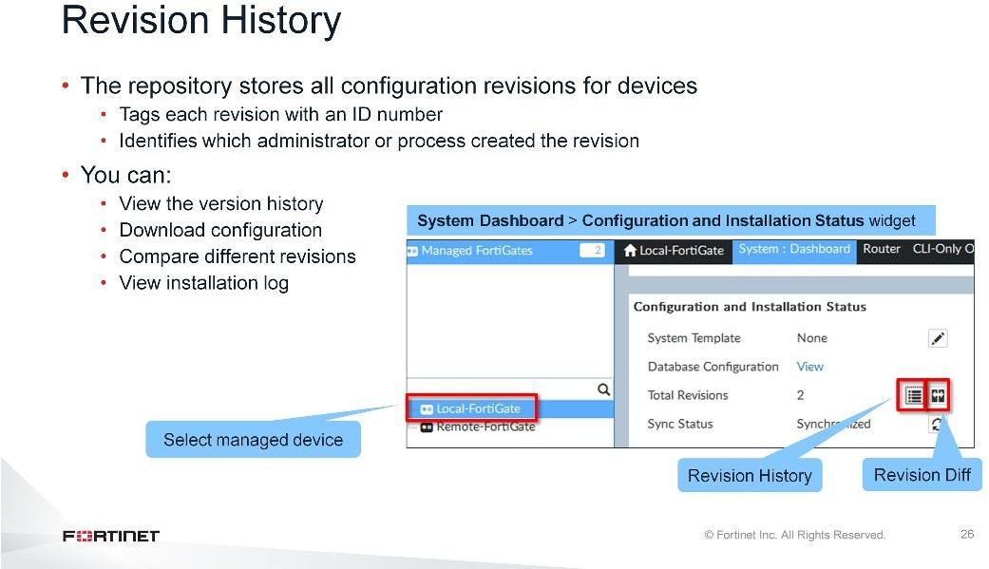
DO NOT REPRINT
© FORTINET
Device Level Configuration and Installation
If the managed FortiGate device configuration is modified directly from the FortiGate, FortiManager compares the checksum with the latest revision history to the running configuration on the FortiGate, and creates a new revision history in its repository. It then updates the FortiManager database, which includes device-level settings only. The policy and objects are updated using the Import Policy wizard.
If the changes are made from FortiManager to the managed device, when performing the install, it will compare the checksum with the latest revision history to the FortiManager database and create a new revision history.
So, when a change in the configuration is detected, FortiManager creates a new revision history and tags it with a version or ID number. Select the device, and in Configuration and Installation widget, you can view, download, or compare the differences between revisions. Revision history also allows you to view the installation performed from FortiManager.

Slide 27
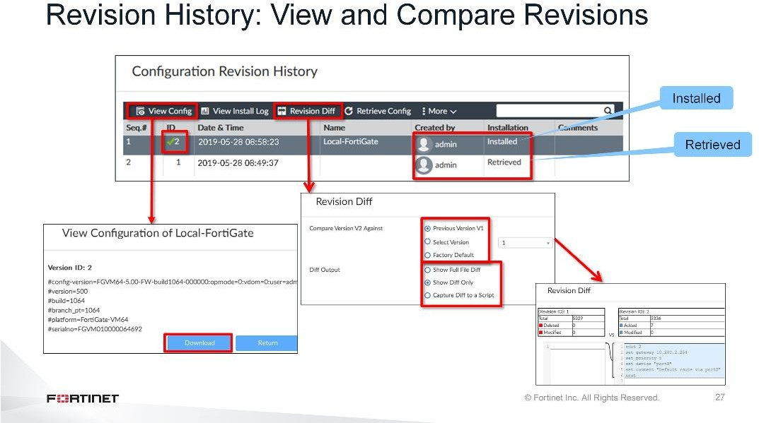
DO NOT REPRINT
© FORTINET
Device Level Configuration and Installation
The Revision History repository stores all configuration revisions for the devices, and tags each revision with a version or ID number. The Installation and Created by columns provide details about the action, process, or administrator that created the revision.
You can select revision ID to view or download the configuration revision. This is the complete configuration of managed device including device level, policies, and object configuration.
After every retrieve and install operation, the FortiManager stores the FortiGate’s configuration checksum output with the revision history. This is how the out-of-sync condition is calculated.
You can also compare the differences between the revision histories by clicking Revision Diff. You can compare the revision history to a previous version, select a specific version, or can compare to the factory default configuration. In terms of the output, you can choose to show the full configuration with differences, only differences, or you can capture the differences to a script.

Slide 28
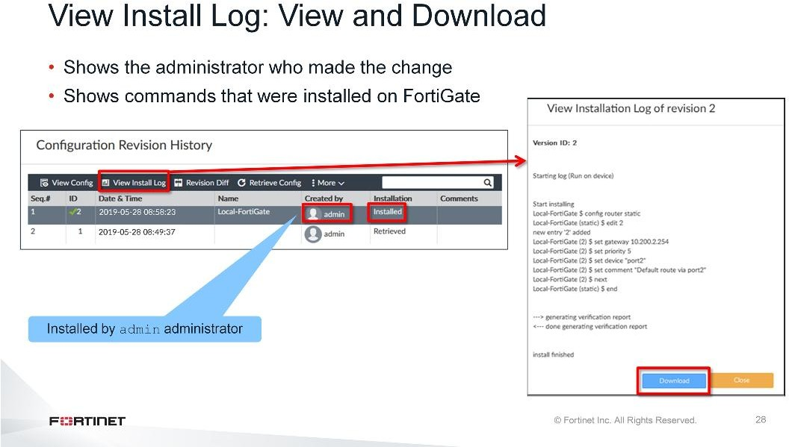
DO NOT REPRINT
© FORTINET
Device Level Configuration and Installation
When the installation is done from FortiManager, the installation log shows the name of the administrator who made the change. When an install is performed, the Installation column is automatically filled with Installed entry. These are the revisions for which you can view install logs.
You can view the commands sent for that revision ID by selecting the revision ID and clicking View Install Log. If an installation fails because there is no rollback, this history is useful because it shows what commands were sent to, and accepted by the device, as well as the commands that were not accepted.
You can also click Download to download this file in .txt format.

Slide 29
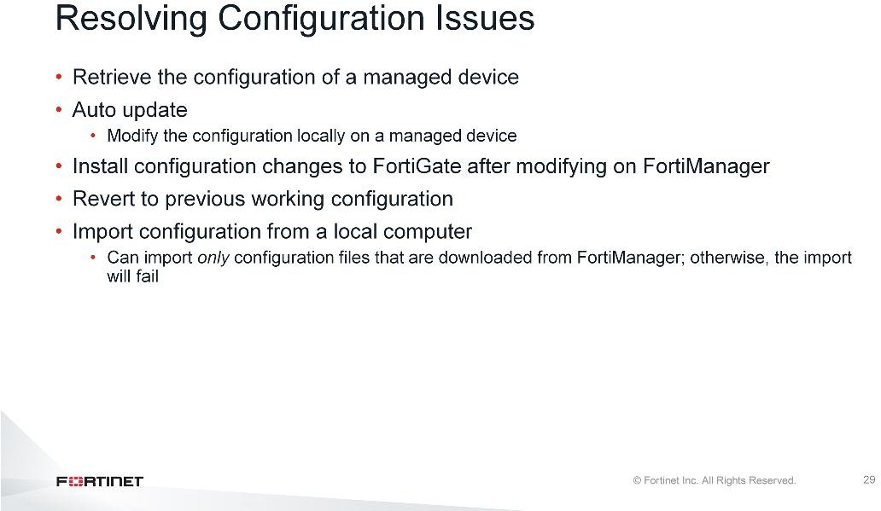
DO NOT REPRINT
© FORTINET
Device Level Configuration and Installation
If you are not satisfied with the running configuration there are multiple ways to resolve the configuration issues. You can:
Modify the configuration on FortiManager and then install it to the managed device
Modify the configuration directly on the managed device
Retrieve the configuration
Revert to a previous configuration
Import the FortiGate configuration from a local computer
Note that FortiManager supports importing only configuration files that are downloaded from FortiManager.

Slide 30
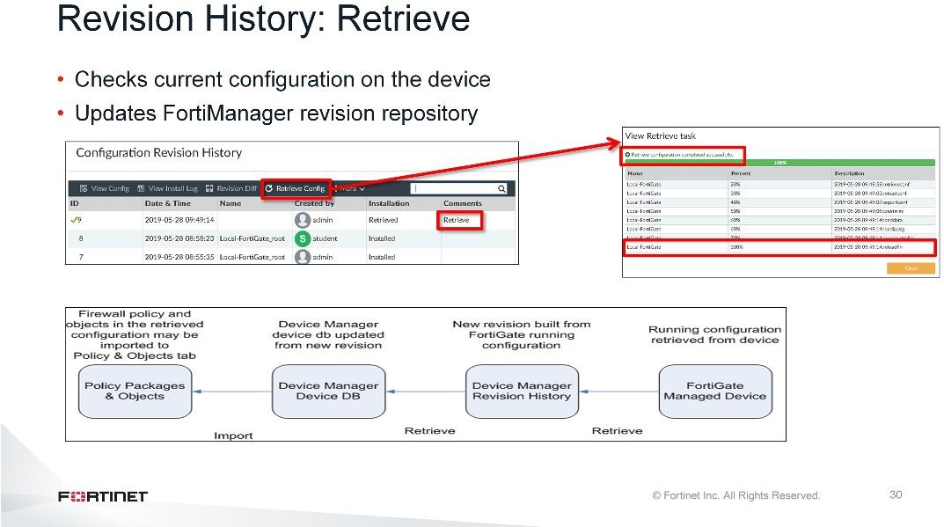
DO NOT REPRINT
© FORTINET
Device Level Configuration and Installation
The revision history also allows you to create a new revision from the device’s running configuration. Click Retrieve Config. FortiManager checks and compares the configuration on the managed device and current revision history on FortiManager. If there is a difference, FortiManager creates a new revision history with a new ID number.
This option can be used to resync the FortiGate device with the FortiManager device database. However, when retrieving a configuration, firewall policy changes need to be imported to the Policy & Objects pane.
The Comments column automatically generates a comment if a retrieve operation is performed.

Slide 31
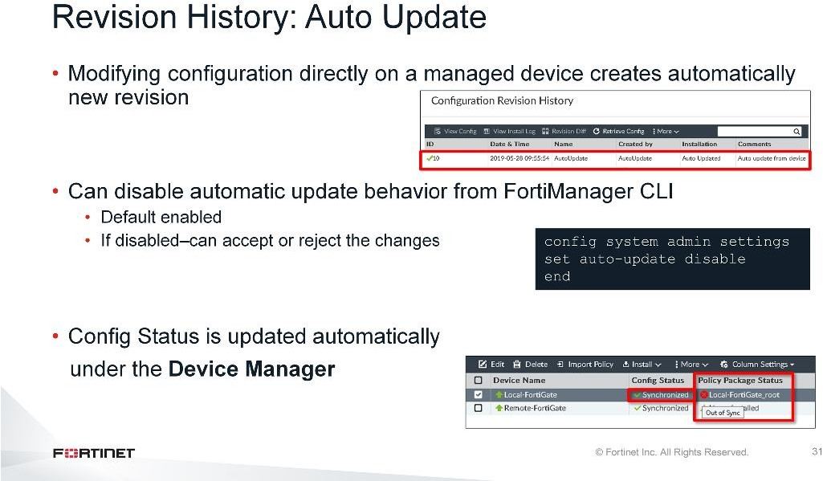
DO NOT REPRINT
© FORTINET
Device Level Configuration and Installation
By default, all changes made directly on the FortiGate device are automatically updated (retrieved) by FortiManager, and reflected in Revision History and Config Status for that device in the Device Manager.
You can disable the auto-update behavior, which allows the FortiManager administrator a choice to accept or refuse the automatic update.
If an automatic update occurs, it is no longer possible for FortiManager to be sure the selected policy package is the same as the running firewall policy. As such, Policy Package Status returns an Out of Sync error.
You must run the Import Policy wizard on FortiManager to sync the policy package.

Slide 32
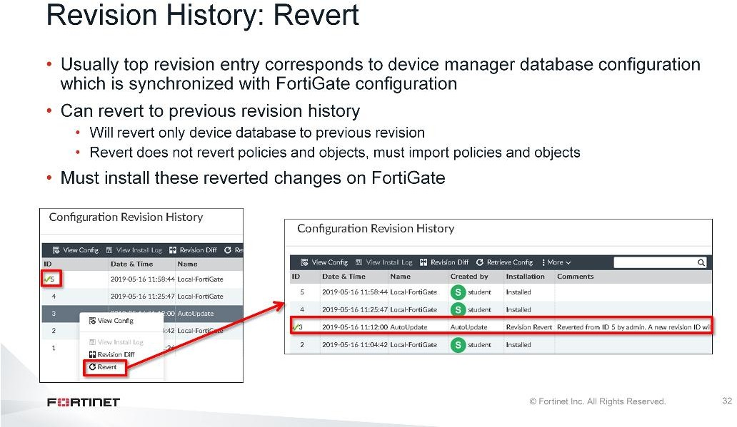
DO NOT REPRINT
© FORTINET
Device Level Configuration and Installation
The green checkmark in the revision history indicates which revision history configuration corresponds to the device manager database configuration. It is usually the top entry, which is synchronized with the FortiGate configuration.
A revert operation within the revision history will change the device database configuration to a previous configuration state. You must install these reverted changes on FortiGate, which will create a new revision entry. This new revision will be a copy of the reverted one, and in sync with the FortiGate configuration.
Revert followed by installation would only revert device-level changes. Keep in mind that revert does not revert policy packages, you will need to import policies and objects.
You can revert to any previous revision by right-clicking that entry and then clicking Revert. The selected previous entry for revert will auto update the Installation column to Revision Revert. FortiManager also updates the Comments column stating from which revision it is reverted and that installation is required.

Slide 33
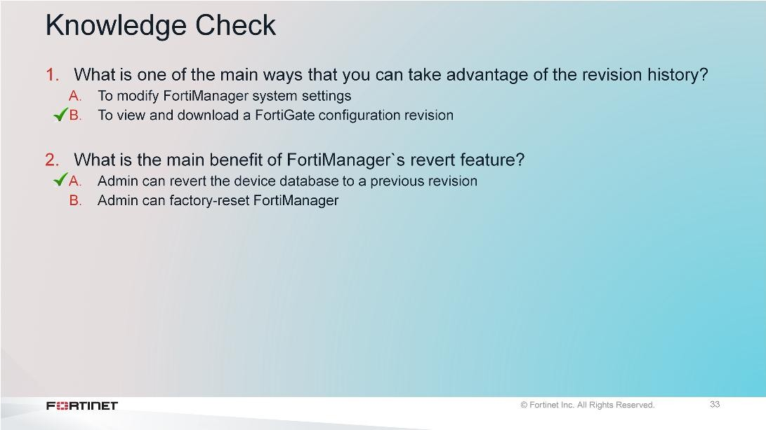
DO NOT REPRINT
© FORTINET
Device Level Configuration and Installation

Slide 34
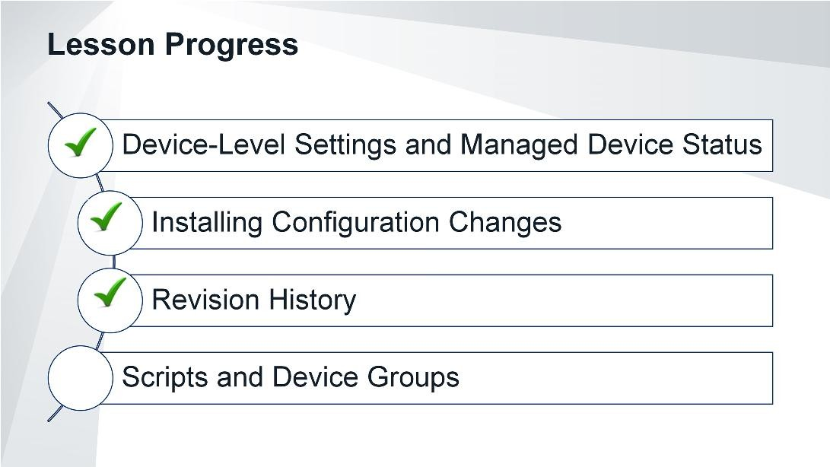
DO NOT REPRINT
© FORTINET
Device Level Configuration and Installation
Good job! You now understand the purpose of revision history and how it can be used.
Now, you will learn about scripts and device groups.

Slide 35
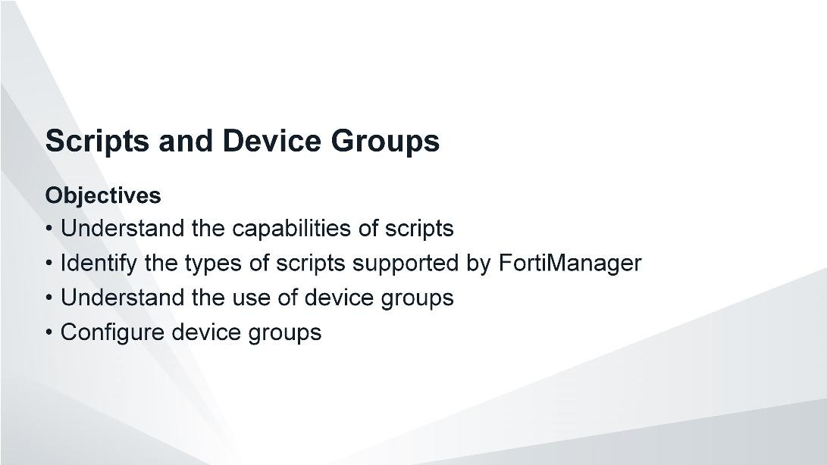
DO NOT REPRINT
© FORTINET
Device Level Configuration and Installation
After completing this section, you should be able to achieve the objectives shown on this slide.
By demonstrating competence in using scripts, you will be able to use scripts to make many changes to managed FortiGates. Using device groups, you will be able to administer and manage FortiGates more effectively and efficiently.

Slide 36
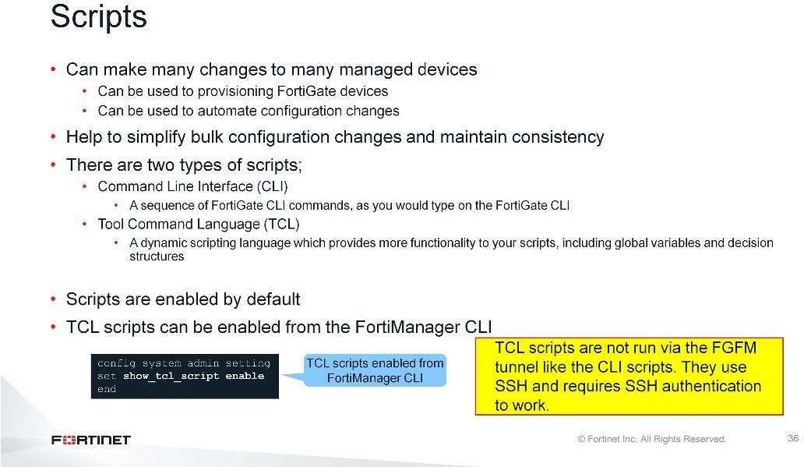
DO NOT REPRINT
© FORTINET
Device Level Configuration and Installation
Scripts can make many changes to a managed device and are useful for bulk configuration changes and consistency across multiple managed devices.
FortiManager supports two types of scripts:
CLI : CLI scripts include only FortiOS CLI commands as they are entered at the command line prompt on a FortiGate device.
TCL : TCL is a dynamic scripting language that extends the functionality of CLI scripting. In FortiManager TCL scripts, the first line of the script is number sign (#) plus exclamation mark (!), which is for standard TCL scripts. Do not include the exit command that normally ends TCL scripts; it will prevent the script from running. You must be familiar with the TCL language and regular expressions. For more information about TCL scripts, visit the official TCL website: http://www.tcl.tk
Scripts are enabled by default. For TCL scripts, you also need to enable the show command from the FortiManager CLI.
Note that TCL scripts do not run through the FGFM tunnel like CLI scripts do. TCL scripts use SSH to tunnel through FGFM and they require SSH authentication to do so. If FortiManager does not use the correct administrative credentials in Device Manager, the TCL script will fail. CLI scripts use the FGFM tunnel and the FGFM tunnel is authenticated using the FortiManager and FortiGate serial numbers.
In this lesson, you will learn about only CLI scripts.

Slide 37
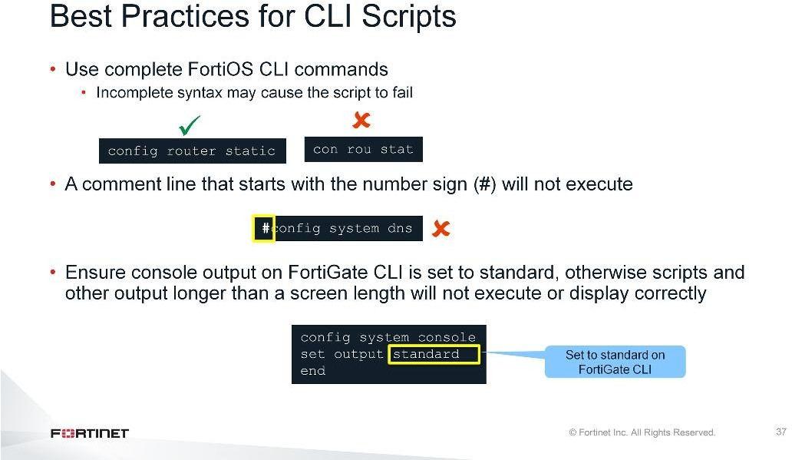
DO NOT REPRINT
© FORTINET
Device Level Configuration and Installation
When creating CLI scripts, follow these best practices:
Use complete FortiOS CLI commands. Partial syntax can be used; however, it may cause the script to fail.
A comment line that starts with the number sign (#) will not execute.
In the FortiGate CLI, ensure the console output is set to standard. Otherwise, scripts and other output longer than a screen in length will not execute or display correctly.

Slide 38
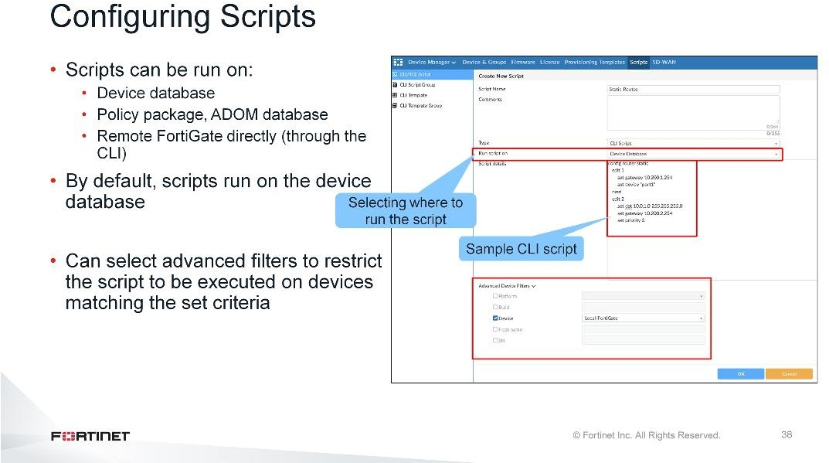
DO NOT REPRINT
© FORTINET
Device Level Configuration and Installation
Scripts can be run in three different ways:
Device Database: By default, a script is executed on the device database. It is recommend you run the changes on the device database (default setting), because this allows you to check what configuration changes you will send to the managed device. Once scripts are run on the device database, you can then install the changes on a managed device using the installation wizard.
Policy Package, ADOM Database: If a script contains changes related to ADOM-level objects and policies, you can change the default selection to run on Policy Package, ADOM database and can then be installed using the installation wizard.
Remote FortiGate Directly (through the CLI): A script can be executed directly on the device and you don’t need to install the changes using the installation wizard. As the changes are directly installed on the managed device, no option is provided to verify and check the configuration changes through FortiManager prior to executing it.
You can also apply options in Advanced Device Filters, which you can use to restrict the scripts to running on managed devices only if the device matches the set criteria.

Slide 39
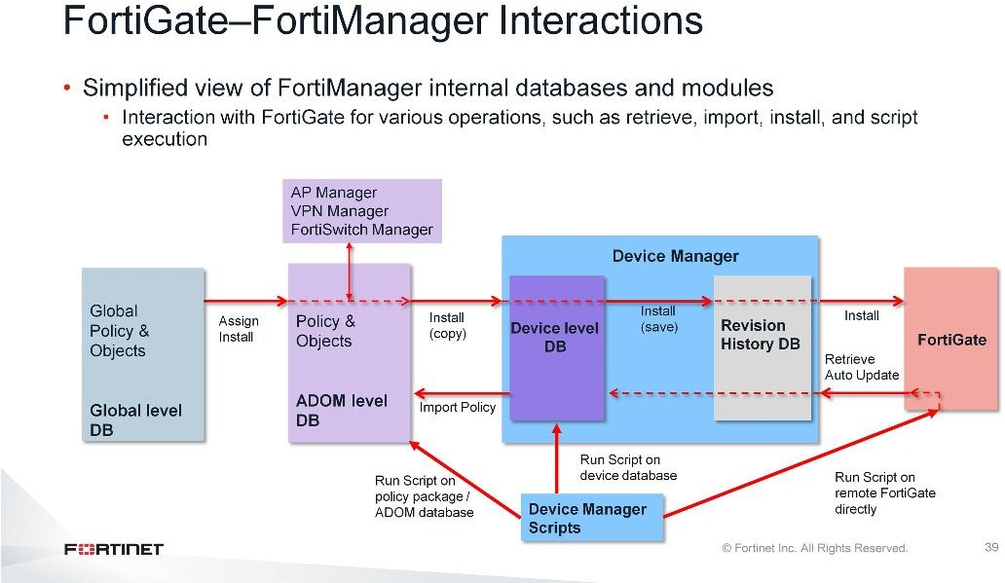
DO NOT REPRINT
© FORTINET
Device Level Configuration and Installation
This diagram shows FortiManager-FortiGate interactions. As this slide shows, when you perform an installation from FortiManager to FortiGate, FortiGate creates a new revision history.
If you run a script on a device database or on a policy package, you must perform an installation on managed devices.
If you run a script directly on a remote device, an auto update occurs, creates new revision, and updates the device-level database.
If you perform a retrieval from FortiManager, or an auto update occurs, FortiManager creates new revision history. If the changes are related to policies or objects, you must run the Import Policy wizard to import policies and objects in the ADOM database.

Slide 40
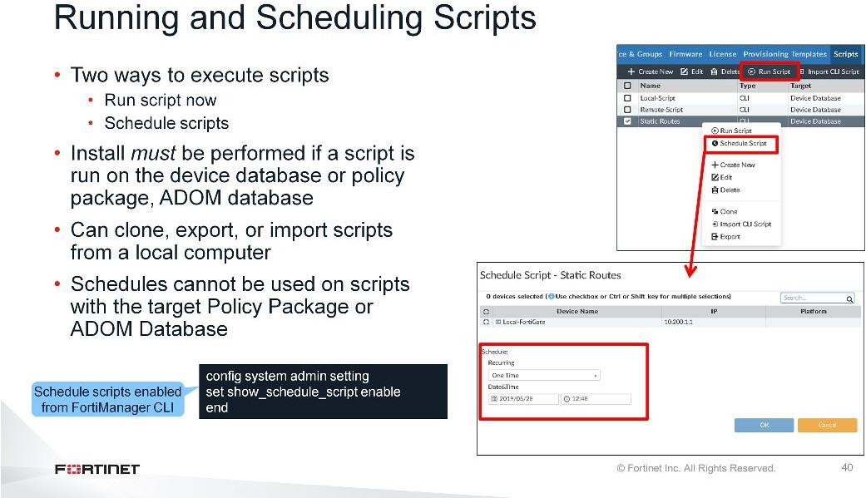
DO NOT REPRINT
© FORTINET
Device Level Configuration and Installation
Once you’ve configured the script, you can browse the ADOM script list for the ADOM that contains the script you would like to run.
To run the script now, select the script and click Run Scripts Now.
You can also schedule the script to run at specific time, for example, outside of business hours. This is useful when you don’t want to interfere with the production network in the business hours. To open the window where you can schedule the script to run, right-click the script and click Schedule Scripts. Schedules cannot be used on scripts with the target Policy Package or ADOM Database.
The right-click menu also provides other options, such as create new script, edit, clone, and delete the existing script. You can also export the script by clicking Export. The exported script can be saved on your local computer in .txt format. Scripts can also be imported as text files from your local computer by clicking Import.

Slide 41
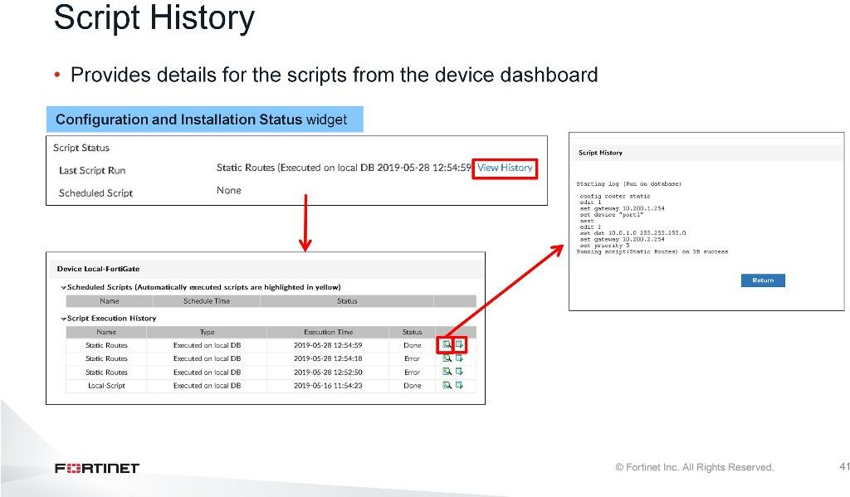
DO NOT REPRINT
© FORTINET
Device Level Configuration and Installation
To view the script history, go to the device dashboard. Under the Configuration and Installation Status widget, click View History to open the Script Execution History table. This table provides additional information such as name, type, execution time, and status of the script. Click the Browse icon to open the Script History dialog box and confirm that the script ran.
The Script Execution History table also allows you to re-run the script. Click the Run Script Now icon in the far right column of the table to re-run the script.

Slide 42
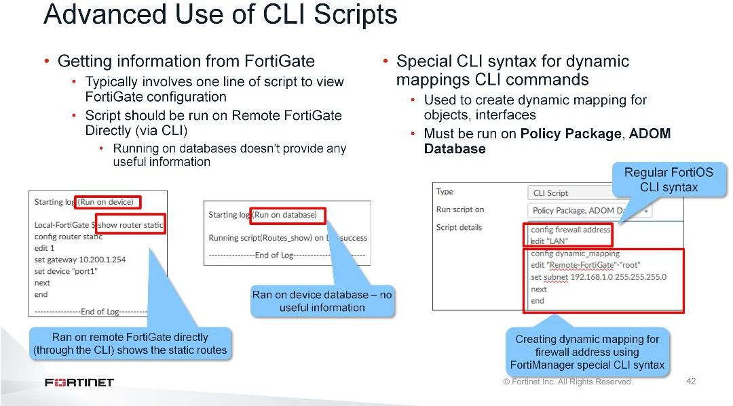
DO NOT REPRINT
© FORTINET
Device Level Configuration and Installation
You can also use scripts to get information from the FortiGate device. These types of scripts are usually one line scripts that use show commands and should be chosen to run on Remote FortiGate Directly (via CLI). Running on device or ADOM database will not provide any useful information.
FortiManager supports dynamic mapping of interfaces and objects so that they can be used with multiple policy packages. You can configure these dynamic mappings from the FortiManager GUI under the Policy & Object pane.
But what if you need to configure dynamic mapping for hundreds of FortiGates for an address object or interface?
You can use scripts which requires special CLI syntax which is applicable to FortiManager internally and is used for creating dynamic mapping. It is two part script:
The top part is the regular FortiOS CLI syntax defining the object
The bottom part is special FortiManager CLI syntax to create dynamic mapping for the object or interface defined in top part

Slide 43
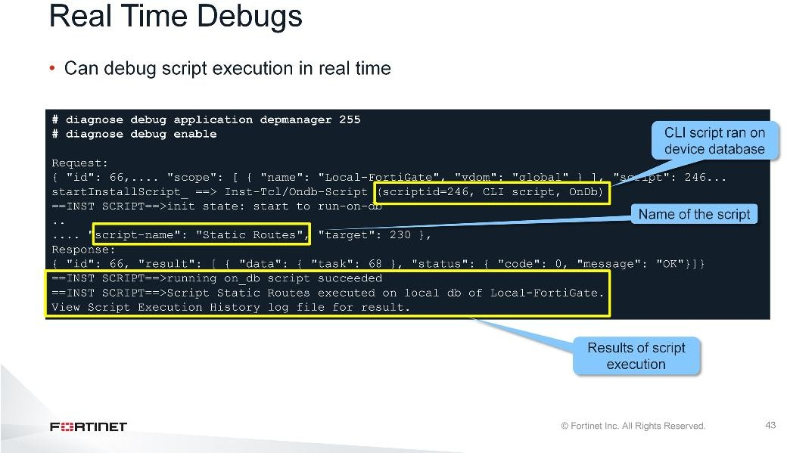
DO NOT REPRINT
© FORTINET
Device Level Configuration and Installation
You can also run a real-time debug on the FortiManager when executing scripts which shows the request performed and the outcome of the request.

Slide 44
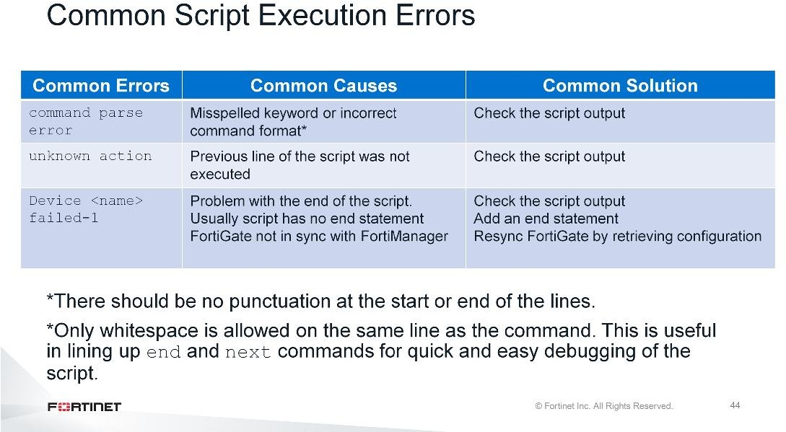
DO NOT REPRINT
© FORTINET
Device Level Configuration and Installation
These are the common errors and common causes for the scripts to fail. You can use these to diagnose and troubleshoot script failure issues and can use common solutions to fix the issue.
The common errors and common causes for the scripts to fail are:
command parse error: It was not possible to parse this line of your script into a valid FortiGate CLI
command. This is usually caused by misspelled keywords or an incorrect command format.
unknown action: Generally this message indicates the previous line of the script was not executed
causing the following CLI commands to fail to execute properly.
Device <name> failed-1: This usually means there is a problem with the end of the script. The
<name> is the name of the FortiGate on which the script is executed. If a script has no end statement or
that line has an error in it you may see this error message. You may also see this message if the FortiGate unit has not been synchronized by deploying its current configuration.
To resolve the script failure issues, use the script history which shows what CLI commands are executed and on which CLI commands it is failing to execute.

Slide 45
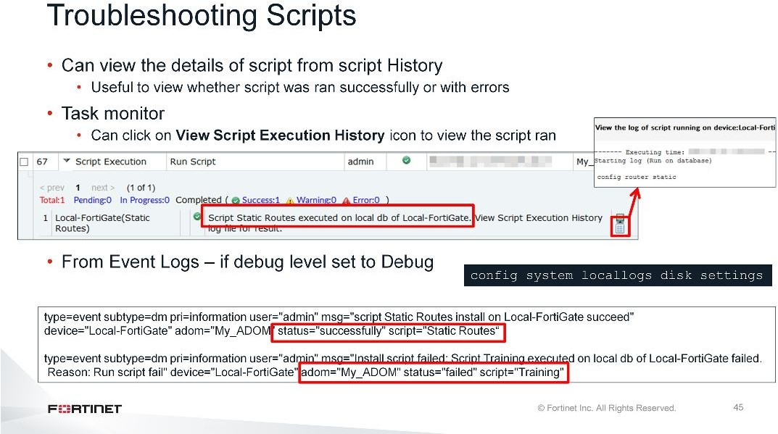
DO NOT REPRINT
© FORTINET
Device Level Configuration and Installation
When troubleshooting scripts, you can check the Script History to see details about the script. The task monitor also provides the same information along with other tasks performed. You can also change the logging level to debug for event logs which creates the log for the actions performed.

Slide 46
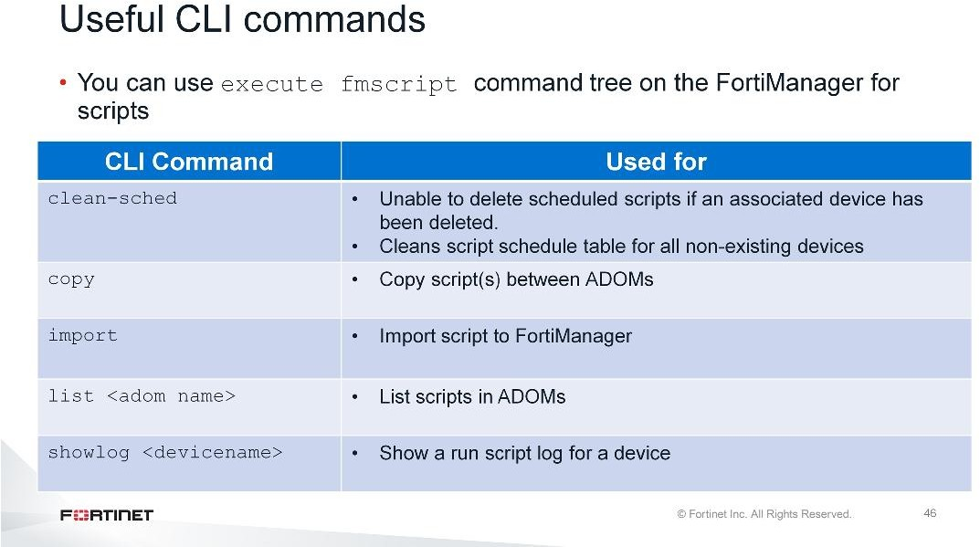
DO NOT REPRINT
© FORTINET
Device Level Configuration and Installation
You can use execute fmscript command tree on the FortiManager for scripts.
The execute fmscript command tree on the FortiManager provided various commands for scripts, such as deleting scheduled scripts, copying scripts between ADOMs, importing scripts, listing all the configured scripts in a ADOM, or showing the script log for a device.

Slide 47
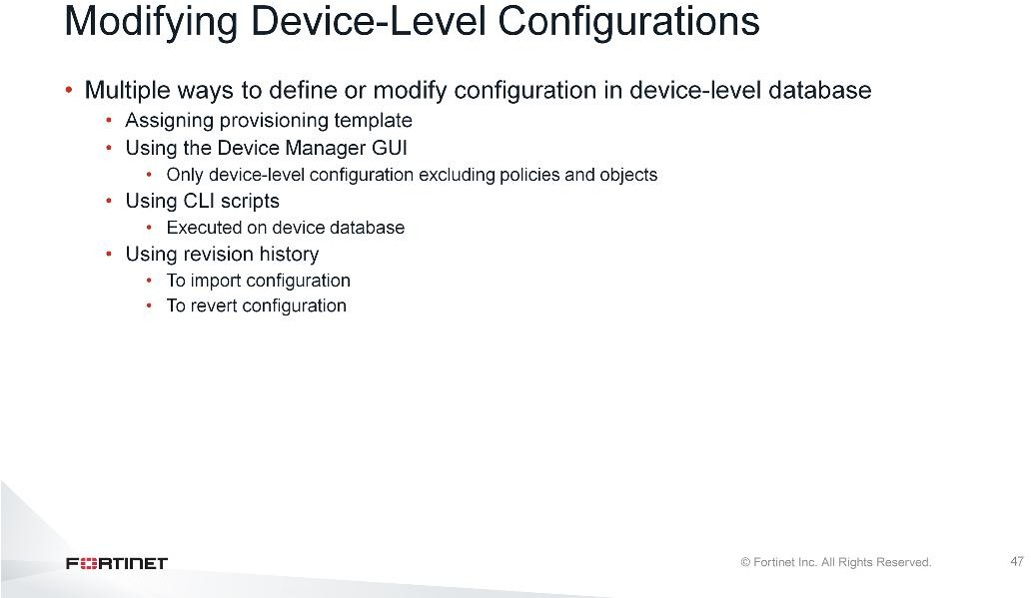
DO NOT REPRINT
© FORTINET
Device Level Configuration and Installation
To summarize, this slide shows the ways that you can make configuration changes to the device-level settings for the managed FortiGate.

Slide 48
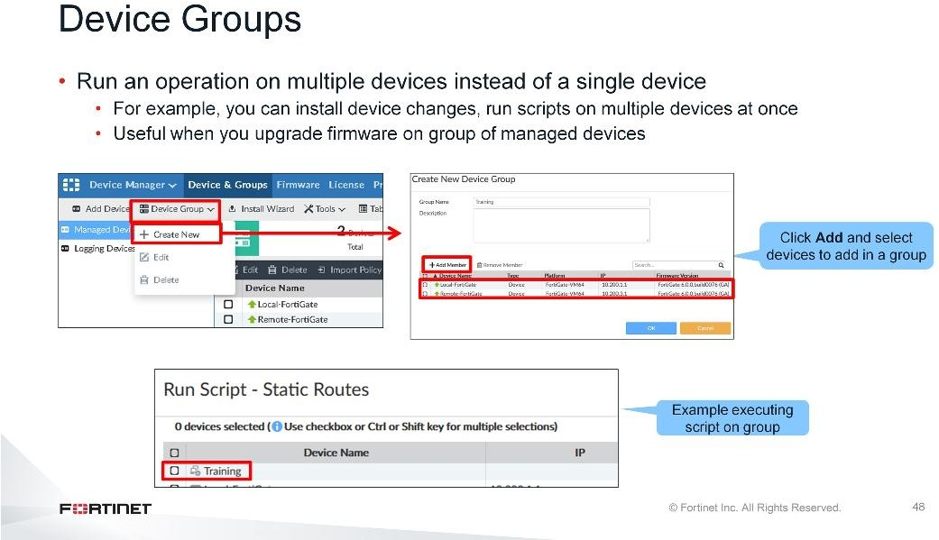
DO NOT REPRINT
© FORTINET
Device Level Configuration and Installation
You can create device groups in an ADOM. You can use device groups to simplify a management action by providing a target that represents multiple devices for scripts, firmware upgrades and configuration changes.
You can create a new device group by clicking Device Group > Add and selecting the devices to be added in this group.
Note that to delete a device group, you must delete all devices from it first. Similarly, to delete an ADOM, you must delete all device groups from it first.

Slide 49
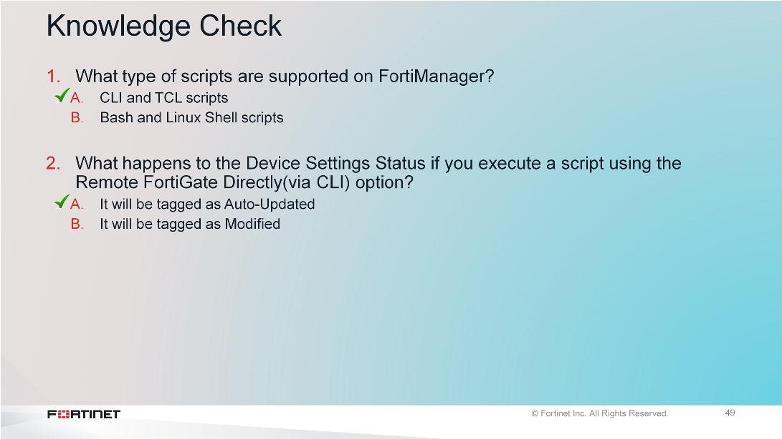
DO NOT REPRINT
© FORTINET
Device Level Configuration and Installation

Slide 50
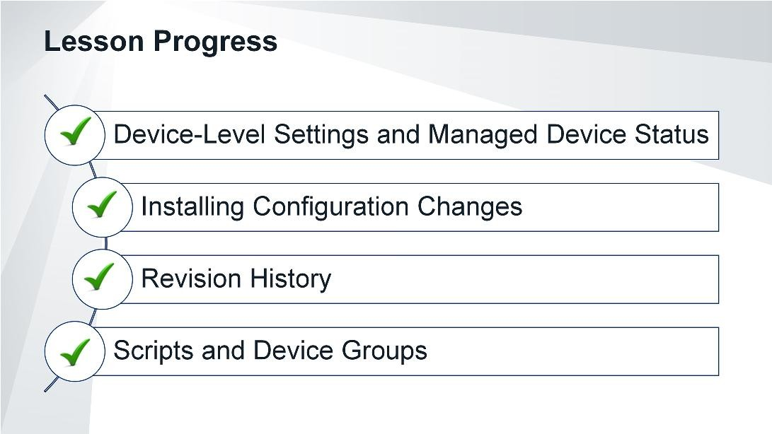
DO NOT REPRINT
© FORTINET
Device Level Configuration and Installation
Congratulations! You have completed this lesson.
Now, you will review the objectives that you covered in this lesson.

Slide 51

DO NOT REPRINT
© FORTINET
Device Level Configuration and Installation
This slide shows the objectives that you covered in this lesson.

Slide 52

DO NOT REPRINT
© FORTINET
Policy and Objects
In this lesson, you will learn how to manage policy and objects on FortiManager for FortiGate. You will configure policy and objects on FortiManager, and then install them on FortiGate.

Slide 53

DO NOT REPRINT
© FORTINET
Policy and Objects
In this lesson, you will explore the topics shown on this slide.

Slide 54

DO NOT REPRINT
© FORTINET
Policy and Objects
After completing this section, you should be able to achieve the objectives shown on this slide.
Before FortiManager can manage policies and objects for managed security devices, you must understand the features of the Policy & Objects pane, which you use to customize policies in an organization. Typically, administrators may want to customize access and policies based on factors such as geography, or security or legal requirements.
In this lesson, you will explore the Policy & Objects pane on FortiManager.

Slide 55

DO NOT REPRINT
© FORTINET
Policy and Objects
You can create multiple policy packages in a single ADOM. FortiManager allows you to customize policy packages for each device or VDOM in a specific ADOM. You can point these policy packages to a single device, multiple devices, all devices, a single VDOM, multiple VDOMs, or all devices in a single ADOM. FortiManager helps simplify provisioning of new devices, ADOMs, or VDOMs by allowing you to copy or clone existing policy packages. You can also create the ADOM revision, which allows you to maintain a revision of the policy packages and objects settings in an ADOM.

Slide 56

DO NOT REPRINT
© FORTINET
Policy and Objects
Policy packages simplify centralized firewall policy management by providing a useful container for your firewall rule set. Policy packages contain firewall policies which, in turn, link to the objects you define on the Object Configuration pane. Objects share the common object database for each ADOM. You can share objects among multiple policy packages in the ADOM.
You can manage a common policy package for many devices in an ADOM, or have a separate policy package for each device. Policy packages allow you to maintain multiple versions of the rule set. For example, you can clone a policy package before you make changes, which allows you to preserve the previous rule set.
A word of caution: While policy packages allow for multiple versions of a firewall policy rule set, the objects referenced in those packages do not have multiple versions—they use only a current value.
For example, let’s say you clone a policy package, add a new rule, and then change the value of a shared object. If you return to a previous version of the policy package, you will back out of the rule that you added, but not the modification to the shared object. The only way to return to a previous version of the policy package, including backing out of the rule that you added and the modification to the shared object, is to use ADOM revisions, which takes a snapshot of the Policy & Objects database for that ADOM.

Slide 57

DO NOT REPRINT
© FORTINET
Policy and Objects
In a single ADOM, administrators can create multiple policy packages. FortiManager allows you to customize the policy packages for each device or VDOM in a specific ADOM, or apply a single policy package for multiple devices in an ADOM. By defining the scope of a policy package, an administrator can modify or edit the policies in that package, without changing other policy packages.

Slide 58

DO NOT REPRINT
© FORTINET
Policy and Objects
All objects in an ADOM are managed by a single database that is unique to that ADOM. Objects inside the database include firewall objects, security profiles, users, and devices.
Objects are shared in the ADOM and can be used among multiple policy packages. This simplifies the job of the administrator. For example, you can create a security profile once and attach it to multiple policy packages for installation on multiple FortiGate devices.
To create or edit the existing object, in Object Configurations, select the object type from the menu on the left side of the screen.

Slide 59

DO NOT REPRINT
© FORTINET
Policy and Objects
The Display Options feature allows you to display specific features in the GUI. The available display options depend on the ADOM version and vary from one ADOM to another.
By default, when you open Display Options, the check boxes for the most common options are selected. You can show or hide a feature in Display Options by selecting or clearing the check box beside the feature. You can show all of the options in a category by selecting the check box beside the category name, or show all of the categories by selecting Check All at the bottom of the Display Options window.
You can also enable additional firewall policy types such as NAT64, IPv6, and interface policies in Display Options.

Slide 60

DO NOT REPRINT
© FORTINET
Policy and Objects
Policy folders help you manage your policy packages. You can customize policies based on organization, geography, security requirements, or legal requirements, and organize policies in specific policy folders.
You can create new policy folders sub-folders in policy folders to help you better organize your policy packages.

Slide 61

DO NOT REPRINT
© FORTINET
Policy and Objects
To create or edit a policy, in a policy package, select IPv4 Policy. You can create a new policy or edit an existing policy. Right-click the sequence number of an existing policy to view more options such as clone, cut, paste, move, and so on.

Slide 62

DO NOT REPRINT
© FORTINET
Policy and Objects
To add objects to, or remove objects from, the firewall policy, click the Object Selection column. The currently used object is highlighted in yellow. When you select other objects in the list, they are highlighted in yellow.

Slide 63

DO NOT REPRINT
© FORTINET
Policy and Objects
In a policy package, you can search or filter policies. You can perform the following types of searches:
Simple search: This option is selected by default and highlights text that matches the string you enter in the search box.
Column filter: You can switch to column filter by clicking the column filter icon. It allows you to search for the firewall by column. You can add multiple filters, and apply Or or Not conditions to the search.
Find and Replace: You can find and replace objects used in multiple policies and policy packages. Right- click an object, and select Find and Replace. All policies in all policy packages are searched, and all occurrences of the found object are displayed in the Find and Replace dialog box. You can replace some objects with multiple objects.

Slide 64

DO NOT REPRINT
© FORTINET
Policy and Objects
A policy package has an installation target on one or more devices or VDOMs. Policy packages can share the same installation target, however, only one policy package can be active on a device or VDOM. The active policy package is listed on the Device Manager pane.
You can add, edit, or delete an installation target on the Installation Targets pane.
After you add an installation target, it appears in the list of Installation Targets. When you install a newly- assigned policy package on a target, the installation wizard displays a warning message that contains the name of the previously-assigned policy package.
After you install the new policy package, it appears as the active policy package for these devices or VDOMs on the Device Manager pane, in the Policy Package Status column.

Slide 65

DO NOT REPRINT
© FORTINET
Policy and Objects
What if you need to share a policy package among many devices, with the exception of only a few policies for specific FortiGate devices?
You can perform granular installation targets per rule in the actual policy by clicking the Install On column. This allows you to target devices to add, remove, or set to defaults.
So, by using an installation target, you can share a policy package among multiple devices, and define rules per device in the policy. Shared policy packages are helpful in environments where many devices need to share common policies (with the exception of a few policies that you can target per device), and eliminate the need for multiple policy packages.

Slide 66

DO NOT REPRINT
© FORTINET
Policy and Objects
All objects in an ADOM are managed by a single database unique to the ADOM. Many objects now include the option to enable dynamic mapping. You can use dynamic objects to map a single logical object to a unique definition per device. You can dynamically map common features such as addresses, interfaces, virtual IPs, and IP pools. A common example is a firewall address. You may have a common name for an address object, but have a different value depending on the device it is installed on.
In the example shown on this slide, the dynamic address object LocalLan refers to the internal network address of the managed firewalls. The object has a default value of 192.168.1.0/24. The mapping rules are defined per device. For Remote-FortiGate, the address object LocalLan refers to 10.10.11.0/24, whereas for Local-FortiGate the same object refers to 10.10.10.0/24. The devices in the ADOM that do not have dynamic mapping for LocalLan have a default value of 192.168.1.0/24.
To add devices for dynamic mapping, turn on the Per-Device Mapping switch, and then, in the Per-Device Mapping section, click Create New. In the pop-up window that opens, select the device and set the IP range/subnet.

Slide 67

DO NOT REPRINT
© FORTINET
Policy and Objects
Interface mapping on the Policy & Objects pane dynamically maps to interfaces on the managed device. Firewall policies created in policy packages refer to these mappings. After you install the policy packages, the interface mapping is translated to the local interfaces on the managed device.
Interface mappings that you define in Zone/Interface have two types: zone and interface. The type defines how the rule is translated to the device. When you select Dynamic Interface, it becomes the interface type, and the interface name maps one-to-one to an interface configured on the managed device. If you select Zone, then that zone is created locally on FortiGate.
In the example shown on this slide, External is mapped to wan2. When you install a policy package on FortiGate, External is translated to wan2 locally on FortiGate. TrustedZone is mapped to dmz1 and dmz2. When you install a policy package on FortiGate, it creates the TrustedZone locally on FortiGate device that contains the dmz1 and dmz2 interfaces.
You can use these dynamic interfaces or zones to map multiple FortiGate devices that have different interfaces in the same ADOM.

Slide 68

DO NOT REPRINT
© FORTINET
Policy and Objects
As per the previous slide, External is mapped to wan2 on the managed FortiGate. Therefore, after a firewall policy is installed on the managed FortiGate, the External interface will appear as wan2.
TrustedZone, however, remains untouched, because you installed it on the device as a zone and the dmz1
and dmz2 interfaces are part of it.

Slide 69

DO NOT REPRINT
© FORTINET
Policy and Objects
On FortiManager, it is possible to delete a used object. FortiManager will display a warning message stating that the object is currently used by other firewall policies or objects. To view the references of this object, click Where Used. However, if you delete a used object, FortiManager will replace it with a none object. The none object is equal to null, which means any traffic that meets that firewall policy will be blocked. Unless, there is a more broad policy that still meets the traffic requirement or a policy defined to allow all traffic (catch all).
You should double-check all references to objects before deleting them to avoid unintended firewall policy behavior.

Slide 70

DO NOT REPRINT
© FORTINET
Policy and Objects
Find Unused Objects is a built-in GUI tool available to administrators to help you locate all unused firewall objects in the FortiManager ADOM object database. Find Unused Objects searches all types of firewall objects and displays the results in a pop-up window. You can delete unused objects directly in the Unused Objects pop-up window. This removes the selected address object from FortiManager’s ADOM objects database.

Slide 71

DO NOT REPRINT
© FORTINET
Policy and Objects
Similar to Find Unused Objects, the Find Duplicate Objects tool searches FortiManager’s firewall object database and displays all objects that have duplicate values assigned to them. In the example shown on this slide, the tool found that the address objects LAN and localLAN have the same subnet. After duplicate objects are found, you can use the same wizard to merge objects, if needed.

Slide 72

DO NOT REPRINT
© FORTINET
Policy and Objects
Policy Check provides recommendations only on what improvements can be made—it does not perform any changes. It uses an algorithm to evaluate policy objects based on:
Source and destination interface policy objects
Source and destination address policy objects
Service and schedule policy objects
Policy Check checks for:
Duplication, where two objects have identical definitions
Shadowing, where one object completely shadows another object of the same type
Overlap, where one object partially overlaps another object of the same type
Orphaning, where an object has been defined, but has not been used anywhere
To perform a policy check, select a policy package, and then, in the Policy Package drop-down list, click
Policy Check. In the Policy Consistency Check dialog box, you can select one of the following options:
Perform Policy Consistency Check: This performs a policy check for consistency and provides any conflicts that may prevent your devices from passing traffic
View Last Policy Consistency Check Result: This allows you to view the results of the most recent consistency check
In the example shown on this slide, policy ID 2 and 1 have the same source and destination in terms of interface and objects, but have different services. You can combine these two policies by adding the services to one policy.
It is important to note that the policy check only provides recommendations on what improvements can be made—it does not actually make any changes.

Slide 73

DO NOT REPRINT
© FORTINET
Policy and Objects
To clone a policy package, select the policy package, and then, in the Policy Package drop-down list, click Clone Package. Because the policy package is a clone, it will have the same installation target as the original policy package, but you can edit this. Also you can copy a policy from one policy package to another policy package within the same ADOM.
In the example shown on this slide, the existing policy package Local-FortiGate is cloned and named Clone_of_Local-FortiGate. The newly created policy package has the same installation target devices as Local-FortiGate.
Warning: You should not point more than one policy package at a target because that increases the chance of user error.

Slide 74

DO NOT REPRINT
© FORTINET
Policy and Objects

Slide 75

DO NOT REPRINT
© FORTINET
Policy and Objects
Good job! You now understand policies and object management.
Now, you will examine import and install wizards.

Slide 76

DO NOT REPRINT
© FORTINET
Policy and Objects
After completing this section, you should be able to achieve the objectives shown on this slide.
Now that you understand the options for configuring and managing firewall policies on the Policies & Objects pane, now you will examine the Import Policy wizard and the Install Wizard, which you can use to manage devices on FortiManager.

Slide 77

DO NOT REPRINT
© FORTINET
Policy and Objects
After every retrieve, auto-update, and installation operation, FortiManager stores the FortiGate configuration in the revision history.
The illustration on this slide shows the status of the policy package:
Imported: Indicates that a policy package was successfully imported for a managed device
Installed: Indicates that a policy package was installed on a managed device
Never Installed: Policy package was never created, hence it was never imported for a managed device
Modified: Policy package configuration is changed on FortiManager and changes have not yet pushed to the managed device
Out-of-sync: The latest policy package does not match the policies and object configuration on the latest revision history because of configuration changes made locally on FortiGate or a previous partial installation failure. You should perform a retrieve, and then import policies from FortiManager.
Conflict: If you make policy configuration changes locally on FortiGate and don’t import the changes into the policy package, and you also made the changes on FortiManager, the status enters conflict state.
Depending on the configuration changes, you can either import a policy package or install the changes from FortiManager.
Unknown: FortiManager is unable to determine the policy package status.
You can resolve most policy status issues by importing a policy package or installing a policy package.

Slide 78

DO NOT REPRINT
© FORTINET
Policy and Objects
The screen capture at the top of the slide shows the output of the diagnose dvm device list, in which the policy package is modified while the config status is in sync. This indicates that only the policy package is modified, not the device level settings. The same information is also available on the GUI, as shown in the screen capture at the bottom of the slide.

Slide 79

DO NOT REPRINT
© FORTINET
Policy and Objects
It is common for FortiGate to have a running configuration already. The Import Policy wizard guides you through importing policies and objects into FortiManager. When you import a device, you create a new policy package that does not interfere with other packages. However, objects you import will add to, or update, existing objects. You may want to create a new ADOM revision before performing an import.
If you add an unregistered device to FortiManager, you must run the Import Policy wizard after promoting the device.
The next few slides explore the stages that the wizard guides you through.

Slide 80

DO NOT REPRINT
© FORTINET
Policy and Objects
The first step in the wizard is the Interface Map. By default, interface mappings exist for interfaces configured on the firewall. This allows the device interfaces to be referenced in policy packages. You can rename the ADOM interface mapping in the wizard. In the example shown on this slide, port1 is renamed to External and port3 is renamed to Internal. Policies on the Local-FortiGate are on port1 and port3, but on FortiManager they are referenced locally as External and Internal. Note that by default the Add mappings for all unused device interfaces check box is selected and creates an automatic mapping for the new interface.
The next step in the wizard is the Policy Package. In this step, the wizard performs a policy search to find all policies in preparation for import into FortiManager’s database. You may chose to import all firewall policies, or select specific policies to import. If you choose to import only specific policies into the policy package and later install policy changes, the policies that were not imported will be deleted locally on FortiGate. This is because FortiManager does not have those policies in the policy package.
Also, you can choose whether to import all configured objects, or only the objects referenced by the current firewall policies. Regardless of whether you choose to import only policy-dependent objects or all objects, the system will delete orphan (unused) objects that are not tied to policies locally on FortiGate in the next installation. But if you choose to import all objects, then the system imports all used and unused objects in the FortiManager ADOM object database and can use them later by referencing the policies on FortiManager and installing them on the managed devices.
By default, Import All and Import only policy dependent objects are selected when you run the Import Policy wizard. As a word of caution, if you are managing many devices in an ADOM and select Import all objects for all devices, the object database will become too full of unused objects, which can be overwhelming for an administrator.

Slide 81

DO NOT REPRINT
© FORTINET
Policy and Objects
After the import is complete, the wizard provides the Import Summary and the Download Import Report. You can download the import report, which is only available on the Import Device page. You can view the report using any text editor.
As a best practice, you should download the report.
The import report provides information about FortiGate, the ADOM name on FortiManager, and the policy package name. The report also provides additional information, such as the objects that have been added as new objects. Existing objects that have the same values locally on FortiGate and FortiManager are referred to as DUPLICATE. If the value of an existing object is changed, FortiManager updates that in its database and shows update previous object in the import report.

Slide 82

DO NOT REPRINT
© FORTINET
Policy and Objects
After you make configuration changes to the policy package, the Policy Package Status is flagged as Modified on the Device Manager pane. There are multiple ways to launch the Install Wizard: on the Device Manager pane as well as on the Policy & Objects pane. If you are using ADOMs, make sure you select the ADOM in the ADOM drop-down list first.
Now, you will explore the process of installing policy configuration changes using the Install Wizard. During this process, the policy and device configuration items are installed on the managed device. After the installation is complete, FortiManager and FortiGate are in sync and the Policy Package Status changes from Modified to Installed (Synchronized).

Slide 83

DO NOT REPRINT
© FORTINET
Policy and Objects
When you select Install Policy Package & Device Settings, the Install Wizard installs the policy package and any pending device-level changes.
The policy package you select is displayed and you have the option to create a new ADOM revision for this installation. Note that an ADOM revision is a snapshot of the entire ADOM and not the changes specific to this policy package.
You can also enable Schedule Install, which allows you to specify the date and time to install the latest policy package changes.
The next step is Device Selection. In this step, the wizard displays the devices selected in the installation target for the specific policy package.

Slide 84

DO NOT REPRINT
© FORTINET
Policy and Objects
The next step in the wizard is validation. In this step, the wizard checks that the policy package selected is suitable for the installation targets selected, such as whether the interface mapping reference in the policy package is configured on the installation targets. If the validation fails, the installation will stop.
Before performing the installation, as a best practice, always preview and verify the changes that will be committed to FortiGate. If this is the first installation, you may see many changes, because objects may have been renamed during the import process and unused objects removed from the device configuration. If you don’t want to proceed with the installation, you can cancel the installation at this step in the wizard.
The last step is Install, which is the actual installation. The wizard lists the devices on which configuration changes were installed. Any errors or warnings that occur during installation appear here as well. If the installation fails, the installation history indicates the stage at which the installation failed. You can also check the installation history for the successful installation too.
In the example shown on this slide, the wizard indicates that the configuration changes were successfully installed on FortiGate, and that FortiManager has created a new revision history for this installation.

Slide 85

DO NOT REPRINT
© FORTINET
Policy and Objects
FortiManager also provides a Re-install Policy option. A re-installation is the same as an installation except there are no prompts and it provides the ability to preview the changes that will be installed on the managed device. The Re-install Policy will create a new revision history and apply it to all selected installation targets.

Slide 86

DO NOT REPRINT
© FORTINET
Policy and Objects

Slide 87

DO NOT REPRINT
© FORTINET
Policy and Objects
Good job! You now understand FortiManager policies and objects management, as well as import and install wizards.
Now, you will examine ADOM revision and database versions.

Slide 88

DO NOT REPRINT
© FORTINET
Policy and Objects
After completing this section, you should be able to achieve the objectives shown on this slide.
Now, you will explore ADOM revisions and its affect on Policy & Objects configurations.

Slide 89

DO NOT REPRINT
© FORTINET
Policy and Objects
ADOM revision saves the policy package and objects locally on FortiManager.
You can create a new ADOM revision, view differences between revisions, or revert to a specific ADOM revision. As a word of caution, if you choose to revert to a specific ADOM revision, you will revert all the policy packages and objects based on that revision.
Warning: Keep in mind that ADOM revisions can significantly increase the size of the configuration backup.
You can delete revisions automatically based on given variables, and you can lock individual revisions to prevent them from being automatically deleted. Click Settings for access to the auto-deletion settings.

Slide 90

DO NOT REPRINT
© FORTINET
Policy and Objects
Each ADOM is associated with a specific FortiOS version, based on the firmware version of the devices that are managed in that ADOM. The selected version determines the CLI syntax that is used to configure the devices. Select this version when you create a new ADOM.
You must update all of the FortiGate devices in a ADOM to the latest FortiOS firmware version before you can upgrade the ADOM version.

Slide 91

DO NOT REPRINT
© FORTINET
Policy and Objects
When you move a device from one ADOM to another, policies and objects (used and unused) don’t move to the new ADOM.
If you need to move a device from one ADOM to another, run the import policy wizard to import the policy package into the new ADOM.
What if you need to use unused objects from a previous ADOM in the new ADOM? You can copy objects from one ADOM to another using the FortiManager CLI.
When FortiGate devices are upgraded, it is best to keep them in the same ADOM and use ADOM upgrade. Moving FortiGate devices to a new ADOM introduces additional work and certain complications.

Slide 92

DO NOT REPRINT
© FORTINET
Policy and Objects

Slide 93

DO NOT REPRINT
© FORTINET
Policy and Objects
Good job! You now understand ADOM revision and database versions.
Now, you will examine policy locking and workflow mode.

Slide 94

DO NOT REPRINT
© FORTINET
Policy and Objects
After completing this section, you should be able to achieve the objectives shown on this slide.
Now, you will explore the purpose and use of policy locking and workflow mode on FortiManager.

Slide 95

DO NOT REPRINT
© FORTINET
Policy and Objects
Policy locking is available in workspace normal mode only. Policy locking allows administrators to work on, and lock, a single policy package instead of locking the whole ADOM. In order to use policy locking, you must set workspace-mode to normal. You can lock either the whole ADOM or a specific policy package. Policy locking is an extension of ADOM locking, which allows multiple administrators to work on separate policy packages on the same ADOM at the same time. The policy lock is automatically released at administrator timeout, or if the administrator closes a session gracefully without unlocking the policy package.

Slide 96

DO NOT REPRINT
© FORTINET
Policy and Objects
Instead of workspaces, you can use workflow mode. Before enabling workflow mode, notify other administrators logged in to FortiManager to save their work: it will terminate all management sessions. You can use workflow mode to control the creation, configuration, and installation of firewall policies and objects. Approval is required before changes can be installed on a device. All the modifications made in a workflow mode session must be discarded or submitted for approval at the end of the session. Sessions that are rejected can be repaired and resubmitted for approval as new sessions. All sessions must be approved in the same order in which they were created to prevent any conflicts.
In workflow mode, panes related to FortiGate configuration are read-only at first. To create a new workflow mode session, you must lock the ADOM first, similar to workspaces. You must enable workflow mode in the CLI. Enabling workflow mode will log out all administrators.

Slide 97

DO NOT REPRINT
© FORTINET
Policy and Objects
This illustration on this slide shows how to use workflow mode.
When Admin A locks the ADOM, a green lock icon appears. Admin A has read-write access and creates a new session on the Policy & Objects pane in the ADOM. Admin A makes configuration changes to the managed devices and submits the request for approval to Admin B. This approval submission automatically unlocks the ADOM.
Admin B must have Read/Write permission for workflow approval. Admin B then locks the ADOM and has read-write access. Admin B opens the session list and has the option to approve, reject, discard, or view differences in the changes submitted by Admin A.

Slide 98

DO NOT REPRINT
© FORTINET
Policy and Objects
An administrator must be part of an approval group, and have rights over the ADOM in which the session was created, in order to approve a session. Being part of the Super_Admin profile is not enough to approve a session.
On the Workflow Approval pane, configure the workflow approval matrix using the following values:
ADOM: Select the ADOM you want to apply workflow mode to
Approval Group #1: Add the administrators who will approve the changes in the ADOM
Send email notification to: Send administrators email notifications when another administrator makes changes and submits the changes for approval
Mail server: Select the email server that FortiManager will use to send its notifications on the Mail Server
pane

Slide 99

DO NOT REPRINT
© FORTINET
Policy and Objects
The administrator must lock the ADOM before they are allowed to create a new session. Once the ADOM is locked, the administrator has the option to create a new session and start making changes to the policy package. Note that the administrator cannot make any changes to policy packages until they create a new session.

Slide 100

DO NOT REPRINT
© FORTINET
Policy and Objects
After you edit firewall policies or objects, click Save to save your session, then submit your changes. Alternatively, you can click Submit, which saves and submits the changes automatically. You can view a session diff before submitting the session for approval.
After you submit your changes for approval or have discarded them, the ADOM automatically returns to the unlocked state.

Slide 101

DO NOT REPRINT
© FORTINET
Policy and Objects
After the workflow request is submitted, administrators with the appropriate permissions can approve or reject the pending request.
The approval administrator must lock the ADOM during the decision process. After the ADOM is locked, they can open the session list. The session list shows the administrator who submitted the request and other information such as date of submission, total requests, and comments by the submitting administrator.
The approver administrator has four options:
Approve: The session is waiting to be reviewed and approved. If the session is approved, no further action is required.
Reject: If the session is rejected, the system sends a notification to the administrator who submitted the session. The approver administrator has the option to repair the changes. A session that is rejected must be fixed before the next session can be approved.
Discard: The approval administrator doesn’t agree with the changes and discards them. No further action is required.
View Diff: The approval administrator can view the differences between the original policy package and
changes made by the submitting administrator.

Slide 102

DO NOT REPRINT
© FORTINET
Policy and Objects
If a connection to FortiManager unexpectedly closes (PC crashed or browser closed) while an ADOM is locked, it will remain locked until the administrator session times out or the session is deleted. You can delete administrator sessions in the GUI or CLI. After the previous session is deleted, the ADOM will be unlocked immediately.

Slide 103

DO NOT REPRINT
© FORTINET
Policy and Objects

Slide 104

DO NOT REPRINT
© FORTINET
Policy and Objects
Congratulations! You have completed this lesson.
Now, you will review the objectives that you covered in this lesson.

Slide 105

DO NOT REPRINT
© FORTINET
Policy and Objects
This slide shows the objectives that you covered in this lesson.

Slide 106

DO NOT REPRINT
© FORTINET
SD-WAN and Security Fabric
In this lesson, you will learn about SD-WAN, global ADOM, and the Security Fabric.

Slide 107

DO NOT REPRINT
© FORTINET
SD-WAN and Security Fabric
In this lesson, you will explore the topics shown on this slide.

Slide 108

DO NOT REPRINT
© FORTINET
SD-WAN and Security Fabric
After completing this section, you should be able to achieve the objectives shown on this slide.
Now, you will learn about SD-WAN and its feature sets.

Slide 109

DO NOT REPRINT
© FORTINET
SD-WAN and Security Fabric
When you configure an SD-WAN, you must specify at least two member interfaces. You should configure an SD-WAN early during the initial setup of FortiGate because if an interface is already referenced by a firewall policy or static route, you cannot use it as a member interface. If you intend to use an interface as an SD- WAN member, and that interface is being referenced by a firewall policy or static route, you must delete the associated firewall policy and static route before you can assign that interface as an SD-WAN member. SD- WAN supports physical interfaces as well as VLAN, aggregate, and IPsec interfaces.
FortiManager groups all the member interfaces into a single virtual interface: the SD-WAN interface. Using SD-WAN simplifies configuration because the administrator can configure a single set of routes and firewall policies and apply them to all member interfaces. There can be only one SD-WAN interface per VDOM.
The first step in creating an SD-WAN using FortiManager is to enable SD-WAN central management in the ADOM.

Slide 110

DO NOT REPRINT
© FORTINET
SD-WAN and Security Fabric
Configure the Health-Check Servers to be used in SD-WAN Templates and the Performance SLA.
Health-Check Servers is a mechanism for detecting when a router along the path is stopped or degraded. FortiGate can check the status (or health) of each SD-WAN member interface participating in a Performance SLA, by periodically sending probing signals through each member link to a server that acts as a beacon. You can specify multiple servers to act as your beacons. This is to guard against the server being at fault, and not the link.
When you configure SD-WAN, you must specify at least two member interfaces and their associated gateways.

Slide 111

DO NOT REPRINT
© FORTINET
SD-WAN and Security Fabric
SD-WAN Templates allows you to add your SD-WAN components to a single template. You can add interface members, Performance SLA, and SD-WAN Rules.
You can create new SD-WAN rules or use the default implicit rule. The implicit rule is designed to balance the traffic among all the available SD-WAN member links. SD-WAN rules allow you to specify which traffic you want to route through which interface. You can configure the SD-WAN Rules to choose the egress interface based on a link’s latency, jitter, or packet loss percentage that you configured in the Performance SLA section. The rules are evaluated in the same way as firewall policies: from top to bottom, using the first match.

Slide 112

DO NOT REPRINT
© FORTINET
SD-WAN and Security Fabric
You must assign your devices for SD-WAN configuration Assigned Devices section. After you select your device and WAN Template, you will see all your SD-WAN member interfaces.
You must configure correct dynamic interfaces and map ports before you install SD-WAN policies. In this example shown on this slide, Local-Fortigate is a newly imported device and does not have firewall policies or correct port mapping because SD-WAN configuration does not require policies to be associated with its member interfaces. You must correctly map port3 to Local-FortiGate port3 using dynamic mapping as per the example shown on this slide.

Slide 113

DO NOT REPRINT
© FORTINET
SD-WAN and Security Fabric
When using SD-WAN, you do not need to configure multiple firewall policies for individual member interfaces. Firewall policies created with the SD-WAN interface allow traffic to be forwarded through any member interface.

Slide 114

DO NOT REPRINT
© FORTINET
SD-WAN and Security Fabric
Now you can install SD-WAN settings on the FortiGate device. You must still configure a default route when implementing an SD-WAN. The default route configuration using the SD-WAN interface does not require a gateway address because FortiGate will forward packets to the appropriate gateway, based on the member interface gateway information. You can create a static route using device manager or script. If you are using a direct CLI script to create a static route, you must install SD-WAN settings before you run the script on FortiGate.

Slide 115

DO NOT REPRINT
© FORTINET
SD-WAN and Security Fabric
After you install all the settings successfully, you can check the SD-WAN status on the FortiManager SD- WAN Monitor or on the managed FortiGate device.

Slide 116

DO NOT REPRINT
© FORTINET
SD-WAN and Security Fabric

Slide 117

DO NOT REPRINT
© FORTINET
SD-WAN and Security Fabric
Good job! You now understand the SD-WAN.
Now, you will examine the global ADOM.

Slide 118

DO NOT REPRINT
© FORTINET
SD-WAN and Security Fabric
After completing this section, you should be able to achieve the objectives shown on this slide.
Now, you will learn about the global ADOM and its feature sets.

Slide 119

DO NOT REPRINT
© FORTINET
SD-WAN and Security Fabric
Global policies and objects allow administrators to push firewall policies universally, to all ADOMs. Global policy packages must be explicitly assigned to specific ADOMs on which administrators want to install similar policies.
The illustration on this slide shows that different ADOMs can use separate global policies. When you create a global policy package, you can choose ADOMs that you want to apply specific policies to. Furthermore, you can even pick specific policy packages in individual ADOMs that you want to apply the global policies to.
You can create global policy packages based on the type of network environment that you are managing, and apply header or footer policies to meet the security requirements.

Slide 120

DO NOT REPRINT
© FORTINET
SD-WAN and Security Fabric
You can use header and footer policies to wrap policies in each individual ADOM. An example of where header and footer policies would be used is in a carrier environment, in which the carrier would allow customer traffic to pass through their network, but would not allow the customer to have access to the carrier’s network assets.
The illustration on this slide shows how global policies and objects are assigned to ADOM policy packages.
In this section, you will learn how to apply a global header policy in order to deny all TELNET traffic to a public IP address, and then assign it to an ADOM.

Slide 121

DO NOT REPRINT
© FORTINET
SD-WAN and Security Fabric
Enter the Global Database ADOM to access the global policy database. Header policies are the policies located at the top of the policy package in the individual ADOM. Footer policies are the policies located at the bottom of the policy package in the individual ADOM.

Slide 122

DO NOT REPRINT
© FORTINET
SD-WAN and Security Fabric
In the example shown on this slide, we have created a header policy to block TELNET traffic from passing through the managed firewalls. The next step is to assign this policy to one policy package in an individual ADOM.

Slide 123

DO NOT REPRINT
© FORTINET
SD-WAN and Security Fabric
Select the global policy package that you would like to assign to the individual ADOM policy package, and then click Assignment > Add ADOM.
In the example shown on this slide, the default global policy package is added to the four policy packages except default and cloned policy packages in the MyADOM ADOM. After you add the global policy package, the status appears as Pending changes, because it is not assigned to the individual ADOM policy package. The ADOM Policy Packages column shows only four policy packages selected out of six packages available in the MyADOM ADOM. To assign the global policy package to the individual ADOM policy package, click Assign or Assign Selected.
The Assign option commits the global policy package and used objects to the individual ADOM policy package.
Assign Selected, on the other hand, provides more advanced options, including:
Assign used objects only
Assign all objects
Automatically install policies on ADOM devices
After installation, the status changes to Up to date.

Slide 124

DO NOT REPRINT
© FORTINET
SD-WAN and Security Fabric
After the global ADOM objects are assigned, they will appear on the Policy & Objects pane for that ADOM. All global objects start with "g" and are edited or deleted in the global ADOM only.
In the example shown on this slide, the header policy is added to the Local-FortiGate. Only one global policy package can be assigned to an individual ADOM policy package. Assigning an additional global policy package to the same individual ADOM policy package removes previously assigned policies. Also, the header and footer policies can’t be edited and moved between the rules in an individual ADOM policy package.
Policy packages must be installed on the managed devices for the new rules to work. A header policy is installed at the top of the list of firewall rules on the target device.

Slide 125

DO NOT REPRINT
© FORTINET
SD-WAN and Security Fabric

Slide 126

DO NOT REPRINT
© FORTINET
SD-WAN and Security Fabric
Good job! You now understand the global ADOM.
Now, you will examine the Security Fabric and its features.

Slide 127

DO NOT REPRINT
© FORTINET
SD-WAN and Security Fabric
After completing this section, you should be able to achieve the objectives shown on this slide.
By demonstrating competence in understanding the Security Fabric and its feature sets, you will be able to use the Security Fabric effectively in your network.

Slide 128

DO NOT REPRINT
© FORTINET
SD-WAN and Security Fabric
FortiManager can recognize a Security Fabric group of devices and display all units in the group on the Device Manager pane. You can manage the units in the Security Fabric group as if they were a single device. You can view your network topology on FortiManager. Any changes in your topology automatically update on FortiManager. You can also view your Security Fabric data through Fabric View and Security Rating.

Slide 129

DO NOT REPRINT
© FORTINET
SD-WAN and Security Fabric
In FortiManager, you can add an existing Security Fabric group or you can create new Security Fabric settings for your managed FortiGate devices. If you are adding an existing Security Fabric group, you must add the root FortiGate for the Security Fabric group to FortiManager. All the devices in the Security Fabric group are automatically added in Unauthorized Devices after you add the root FortiGate.
In this lesson, you will learn how to create the Security Fabric settings on FortiManager and install settings to managed FortiGate devices. First, you need to enable the Security Fabric features through Global Display Options. Once the Security Fabric feature is enabled, all the Security Fabric settings can be configured for each devices in System > Security Fabric settings.

Slide 130

DO NOT REPRINT
© FORTINET
SD-WAN and Security Fabric
The second step in implementing the Security Fabric is configuring the root and downstream FortiGate devices. In the root and downstream FortiGate devices, you must select the Enable Security Fabric check boxes. Then, you need to configure the same group name and password for both devices. Also, for the down stream FortiGate device, you must configure the up stream FortiGate IP address in the Connect to Upstream FortiGate section.

Slide 131

DO NOT REPRINT
© FORTINET
SD-WAN and Security Fabric
The third step in implementing the Security Fabric is to enable FortiTelemetry on the interfaces facing any downstream or upstream FortiGate devices.

Slide 132

DO NOT REPRINT
© FORTINET
SD-WAN and Security Fabric
Once you have configured all of the Security Fabric settings, then you can install all the changes to both devices using the Install Wizard. In order complete the full Security Fabric process, you will need to configure FortiAnalyzer settings on the root FortiGate and authorize all your devices on the FortiAnalyzer. After authorizing all the devices on the FortiAnalyzer, you can view the successful Security Fabric group on the FortiManager in the Managed Devices section. If you do not see the Security Fabric group name, you may have to right click on the root FortiGate device and refresh it.

Slide 133

DO NOT REPRINT
© FORTINET
SD-WAN and Security Fabric
The Fabric View pane allows you to view Security Fabric ratings of configurations for FortiGate Security Fabric groups. You can view the results for multiple FortiGate Security Fabric groups.

Slide 134

DO NOT REPRINT
© FORTINET
SD-WAN and Security Fabric
The Security Rating feature includes new security checks that can help you make improvements to your organization’s network, such as enforce password security, apply recommended login attempt thresholds, encourage two-factor authentication, and so on. You can view Security Fabric ratings of configurations for all FortiGate devices in a Security Fabric group, or for individual FortiGate devices in a Security Fabric group.
You cannot use FortiManager to generate Security Fabric ratings; you must use FortiOS to generate Security Fabric ratings for a FortiGate Security Fabric group, and then you can see the Security Fabric ratings in FortiManager.
The Security Fabric rating results are displayed on the content pane for the selected Security Fabric group. You can filter the results. For example, you can view only failed results by clicking the Failed button, and you can click the All Results button to view all results again.

Slide 135

DO NOT REPRINT
© FORTINET
SD-WAN and Security Fabric
FortiManager recognizes Security Fabric groups of devices and lets you display the Security Fabric topology. You can click Fabric View > Physical Topology, Logical Topology or right-click a Security Fabric device and select Fabric Topology to view your entire device topology in the Security Fabric group.

Slide 136

DO NOT REPRINT
© FORTINET
SD-WAN and Security Fabric

Slide 137

DO NOT REPRINT
© FORTINET
SD-WAN and Security Fabric
Congratulations! You have completed this lesson.
Now, you will review the objectives that you covered in the lesson.

Slide 138

DO NOT REPRINT
© FORTINET
SD-WAN and Security Fabric
This slide shows the objectives that you covered in this lesson.

Slide 139

DO NOT REPRINT
© FORTINET
Diagnostics and Troubleshooting
In this lesson, you will learn how to diagnose and troubleshoot issues related to FortiManager and managed devices.

Slide 140

DO NOT REPRINT
© FORTINET
Diagnostics and Troubleshooting
In this lesson, you will explore the topics shown on this slide.

Slide 141

DO NOT REPRINT
© FORTINET
Diagnostics and Troubleshooting
After completing this section, you should be able to achieve the objectives shown on this slide.
By demonstrating competence in understanding various FortiManager deployment scenarios, keep-alive messages, and how to replace a managed FortiGate device, you will be able to deploy FortiGate devices in various scenarios and manage FortiGate devices.

Slide 142

DO NOT REPRINT
© FORTINET
Diagnostics and Troubleshooting
In the scenario shown on this slide, FortiManager is operating behind a NAT device. By default, only FortiManager can discover a new device. If the FGFM tunnel is torn down, only FortiManager will try to re- establish the FGFM tunnel. This is because, by default, the NATed FortiManager IP address is not configured on FortiGate central management.
How can FortiGate announce itself to the NATed FortiManager, or try to re-establish the FGFM tunnel if it is torn down?
You can configure the FortiManager NATed IP address on FortiGate under central management configuration. This allows FortiGate to announce itself to FortiManager and try to re-establish the FGFM tunnel, if it is torn down. Configuring FortiManager NATed IP address on FortiGate allows both FortiManager and FortiGate to re-establish FGFM tunnel. Also, if you configure the FortiManager NATed IP address under FortiManager system admin settings, FortiManager set this address on FortiGate during the discovery process.
Note that registering FortiGate to FortiManager through FortiGate`s CLI will fail on FortiManager version 6.0 or higher, when the non-default admin account is used. So, it is highly recommended that you configure the FortiManager NATed IP address under FortiManager system admin settings if the FortiManager is behind a NAT device.

Slide 143

DO NOT REPRINT
© FORTINET
Diagnostics and Troubleshooting
In this scenario, FortiGate is operating behind a NAT device. FortiManager can discover FortiGate through the FortiGate NATed IP address. FortiGate can also announce itself to FortiManager. What if the FGFM tunnel is interrupted? If the FGFM tunnel is torn down, only FortiGate will attempt to re-establish connection.
FortiManager treats the NATed FortiGate as an unreachable device and doesn’t attempt to re-establish the FGFM tunnel. However, you can force a one-time connection attempt from FortiManager by clicking the Refresh icon in the Connection Summary widget for the managed device in Device Manager.

Slide 144

DO NOT REPRINT
© FORTINET
Diagnostics and Troubleshooting
What if both devices–FortiManager and FortiGate–are behind a NAT device? Then, the FortiGate device is discovered by FortiManager through the FortiGate NATed IP address. Just like it was in the NATed FortiManager scenario, the FortiManager NATed IP address in this scenario is not configured under FortiGate central management configuration. FortiManager will not attempt to re-establish the FGFM tunnel to the FortiGate NATed IP address, if the FGFM tunnel is interrupted. If the FortiManager NATed IP address is configured on FortiGate under central management configuration, the FortiGate will try to re-establish the FGFM tunnel, if it is torn down.

Slide 145

DO NOT REPRINT
© FORTINET
Diagnostics and Troubleshooting
The Keepalive messages, including the configuration checksums, are sent from FortiGate at configured intervals. The messages also show the IPS version of the FortiGate device. The keepalive message includes:
fgfm-sock-timeout: The maximum FortiManager or FortiGate communication socket idle time, in
seconds
fgfm_keepalive_itvl: The interval at which the FortiGate will send a keepalive signal to a
FortiManager device to keep the FortiManager or FortiGate communication protocol active
If there are no responses to the keepalive messages for the duration of the sock timeout value, the tunnel is torn down and both ends will attempt to re-established it.

Slide 146

DO NOT REPRINT
© FORTINET
Diagnostics and Troubleshooting
When an install is performed from FortiManager to FortiGate, FortiManager always tries to ensure connectivity with the managed FortiGate. If the connection fails, FortiManager tries to recover the FGFM tunnel by unsetting the command that caused the tunnel to go down.
For each install, FortiManager sends the following commands to the managed FortiGate device:
Set commands, needed to apply the configuration changes
Unset commands, to recover the configuration changes
When applying changes, FortiGate:
Applies the set commands, using memory only, nothing written to a configuration file
Tests the FGFM connection to the FortiManager
If the connection fails to re-establish, FortiGate applies the unset command after 15 minutes (not configurable and not based on sock timeout values). If the connection remains down, and rollback-allow-reboot is enabled on the FortiManager, FortiGate reboots to recover the previous configuration from its configuration file.

Slide 147

DO NOT REPRINT
© FORTINET
Diagnostics and Troubleshooting
FortiManager saves the configuration revisions of a managed device. But what happens if you need to replace the standalone managed device because of hardware failure or RMA?
You can replace the faulty standalone device by manually changing the serial number of the faulty device to the serial number of the replacement device on FortiManager. Then, you redeploy the configuration. The serial number is verified before each management connection, because the licenses are attached to the FortiGate serial number. When replacing a FortiGate cluster member, FortiManager will learn the new serial number through the FGFM tunnel.

Slide 148

DO NOT REPRINT
© FORTINET
Diagnostics and Troubleshooting
Note that the replacement FortiGate should not contact FortiManager before the execute device replace sn <devname> <serialnum> command is run. If it does, you will have to delete the unregistered device entry prior to rerunning the command.
To replace the faulty device with the new device, take the following steps:
Note the device name of the original FortiGate.
If the replacement device is already listed as unregistered, then you will need to delete it from the unregistered device list in the root ADOM.
Add the serial number of the replacement FortiGate.
After the replace command is executed, FortiManager updates the serial number in its database.
Verify that the new device serial number is associated with the faulty device in FortiManager. You can do this using the CLI or the System Information widget of FortiGate.
Send a request from the replacement device to register it with FortiManager.
If connectivity fails after you update the serial number, you might need to reclaim the management tunnel.
The device name is optional. If you run the command without the device name, FortiManager will try to reclaim tunnels
from all managed devices.
Optionally, you can change the device password that you used when you added the device by running the
execute device replace pw <device_name> <password> command.

Slide 149

DO NOT REPRINT
© FORTINET
Diagnostics and Troubleshooting

Slide 150

DO NOT REPRINT
© FORTINET
Diagnostics and Troubleshooting
Good job! You now understand deployment scenarios.
Now, you will learn how to use some diagnostics commands to troubleshoot issues with FortiManager connectivity and performance.

Slide 151

DO NOT REPRINT
© FORTINET
Diagnostics and Troubleshooting
After completing this section, you should be able to achieve the objectives shown on this slide.
By demonstrating competence in using diagnostics and troubleshooting techniques, you will be able to manage and maintain the integrity of FortiGate devices in your network.

Slide 152

DO NOT REPRINT
© FORTINET
Diagnostics and Troubleshooting
This slide shows some CLI commands that you can use for troubleshooting FortiManager connectivity and resource issues.
These commands are similar to the FortiGate commands that you can use to diagnose and troubleshoot common issues. For example, to view the top running processes you can run execute top. You can use the execute iotop command to identify system processes with high i/o usage (usually the disk activity). You can view the crash log entries. If FortiManager is dropping packets or not receiving packets, you can run a packet capture (sniffer) to help diagnose the reason. You can also test the device reachability and can confirm the status of the FGFM tunnel.

Slide 153

DO NOT REPRINT
© FORTINET
Diagnostics and Troubleshooting
The get system performance command provides information about system resource usage and displays the output by resource type:
CPU: provides an over view of CPU usage information on the system. It will show what type of processes
are using what percentage of the CPU
Memory: provides total memory available to the unit and how much memory is currently in use
Hard Disk: provides hard disk usage information, including total disk space available and how much is
in use
Flash Disk: provides flash disk usage information
Always check the Used column to check resource usage. If the resources usage is high, you may experience issues managing devices from FortiManager. For example, adding devices or installing changes may take a long time.

Slide 154

DO NOT REPRINT
© FORTINET
Diagnostics and Troubleshooting
The execute top command displays real-time system statistics that are very useful for system monitoring. The statistics are displayed in rows, as follows:
Row 1 – current time, uptime, users sessions, average system load (last minute, five minutes and 15 mins) Row 2 – total number of processes running, processes actively running, processes sleeping, stopped, in zombie state
Row 3 – CPU usage for: user processes, system processes, priority processes, CPU idle, processes waiting for I/O, hardware irq, software irq and steal time.
Row 4 and Row 5 – memory usage
Row 6 – process ID, user, priority process, nice value of the process, virtual memory usage is a swap file, memory usage is RAM, CPU usage, memory usage percentage, total activity time, state of the process, and name of the process
When you are troubleshooting issues with high CPU or memory usage, check the overall system resources. Then check individual processes for high CPU or memory usage.

Slide 155

DO NOT REPRINT
© FORTINET
Diagnostics and Troubleshooting
FortiManager displays the individual processes that are responsible for high i/o wait state when you use the command execute iotop. You can use this command to identify the process that is causing high i/o usage when you are troubleshooting performance issues related to heavy i/o usage.

Slide 156

DO NOT REPRINT
© FORTINET
Diagnostics and Troubleshooting
Another area you may want to monitor, purely for diagnostics, are the crash logs. The crash logs are available through the CLI. The most recent crash log will be listed at the bottom of the output. In this example, process oftpd was restarted with signal 11, and crash information was logged in the crash log file. The crash log displays the firmware information in the first line, followed by process name, and signal information.
Most of the logs in the crash log are normal. Some logs in the crash log might indicate problems. For that reason, crash logs may be requested by Fortinet Technical Support for troubleshooting purposes.

Slide 157

DO NOT REPRINT
© FORTINET
Diagnostics and Troubleshooting
The packet sniffer command is useful for troubleshooting connectivity and traffic-related issues. The packet sniffer command shown in the slide is set up to capture packets from host 192.168.1.99 on port 541 and to display the packet header only (verbose 1) for five packets and the local timestamp. Unlike FortiOS, FortiManager supports only verbose options 1,2 and 3.
For example, if you are experiencing a connectivity issue between FortiManager and FortiGate, you can sniff for management traffic on TCP port 541 to see if there is any communication between the two devices.

Slide 158

DO NOT REPRINT
© FORTINET
Diagnostics and Troubleshooting
The diagnose systeme print df command displays disk partition information on the FortiManager. It shows the filesystem, size, usage, available disk space, usage in percentage, and mount point. This command can be useful when troubleshooting disk-related issues. It can be helpful to know what each of these partitions are used for on FortiManager:
/dev/shm is used as shared memory
/tmp is a temporary file storage filesystem
/data is the pointer to flash disk partition
/var is used for FortiManager database storage
/drive0 is used as FortiAnalyzer archives and postgres database
/Storage is used for FortiAnalyzer log and report storage

Slide 159

DO NOT REPRINT
© FORTINET
Diagnostics and Troubleshooting
On FortiManager, processes lock and unlock the database, but they should not remain stuck in the locked state. There should be no locks on an idle system.
What if FortiManager is taking too long to complete a task? You can use the proc list command can be
used to identify any process or task that is stuck. A stuck task may prevent other subsequent tasks from being processed. If a task is taking too long to process, it will be listed here. You can cancel or delete the pending (stuck) task from Task Monitor under the System Settings pane.

Slide 160

DO NOT REPRINT
© FORTINET
Diagnostics and Troubleshooting
You can use these debug commands to troubleshoot various issues between FortiManager and FortiGate such as adding, deleting, refreshing, auto-updates, and installing issues.
Before you run any debugs commands, check if any other debug commands are enabled. Running a debug will show the output from all other enabled debugs, if they are not disabled or reset. Always reset the debug level before enabling any new debugs.

Slide 161

DO NOT REPRINT
© FORTINET
Diagnostics and Troubleshooting
An ungraceful shutdown on FortiManager can cause corruption to the file system and internal database. This applies to both hardware and virtual machines. As a best practice, you should check the Alert Message Console and event logs for important messages.
If the FortiManager has lost power, a message on the console connection will advise you to repair the file system. Remember, always back up the FortiManager, prior to repairing the file system. It is also highly recommended that you connect the FortiManager to an uninterruptible power supply (UPS) to prevent an unexpected shut down.

Slide 162

DO NOT REPRINT
© FORTINET
Diagnostics and Troubleshooting
To ensure database integrity on FortiManager, you should follow these best practices:
Always gracefully shut down FortiManager. Using an ungraceful shutdown can damage the internal databases.
If multiple administrators are performing operations on FortiManager, enable ADOM locking to avoid configuration conflicts.
Always follow the proper upgrade path. If you don’t, it may cause inconsistencies in the database.
Make sure all administrators are logged off, and perform database integrity checks before performing a firmware upgrade.
If you cannot resolve a data integrity issue, you can perform a factory reset on FortiManager, and then restore the configuration using a good backup configuration.

Slide 163

DO NOT REPRINT
© FORTINET
Diagnostics and Troubleshooting
If you are experiencing unusual behavior on the FortiManager, check for issues with database integrity. Database integrity commands modify any database errors that are found. It is recommended that you perform a backup before executing database integrity commands. Also it is recommended to have all the administrators log out and all the ADOMs unlocked, if work space mode is enabled prior running the integrity check commands. Having a backup is helpful when you don’t want to keep changes that were made were by the integrity commands and you need to restore FortiManager configuration.
As a best practice, configure a scheduled backup of FortiManager. FortiManager automatically runs database integrity commands prior to a schedule backup, and creates logs. If there are any issues with database integrity, you need to re-run the commands to fix the problem.

Slide 164

DO NOT REPRINT
© FORTINET
Diagnostics and Troubleshooting
This slide lists commands that you can use to verify and maintain database integrity. If you execute a database integrity command that makes a change or correction to the database, it is advised that you then re- run the command to verify that any changes or corrections were made properly.

Slide 165

DO NOT REPRINT
© FORTINET
Diagnostics and Troubleshooting
This slide shows an example of a database integrity check. FortiManager finds no issues with the device manager databases. Second example shows how to check the database integrity on an individual adom.

Slide 166

DO NOT REPRINT
© FORTINET
Diagnostics and Troubleshooting

Slide 167

DO NOT REPRINT
© FORTINET
Diagnostics and Troubleshooting
Good job! You now understand how to diagnose and troubleshoot various issues with FortiManager.
Now, you will learn about troubleshooting device and ADOM databases.

Slide 168

DO NOT REPRINT
© FORTINET
Diagnostics and Troubleshooting
After completing this section, you should be able to achieve the objective shown on this slide.
By demonstrating competence in understanding how to use CLI commands related to device-level and ADOM-level databases, you will learn how to troubleshoot device-level and ADOM-level issues.

Slide 169

DO NOT REPRINT
© FORTINET
Diagnostics and Troubleshooting
If you need to verify which templates are applied to which FortiGate device, you can check from the Provisioning Templates widget, or from the individual device(s) Configuration and Installation Status widget.
In this example, the default system template is applied to Local-FortiGate and Remote-FortiGate for DNS settings.

Slide 170

DO NOT REPRINT
© FORTINET
Diagnostics and Troubleshooting
You can use this command to view to the CLI configuration of templates. You can see which CLI commands will be pushed to FortiGate.
Tip: Use ? for help. In this example, the default system template is configured with primary and secondary
DNS entries. Remember that the default system template is applied to Local-FortiGate and Remote-FortiGate, as shown in the previous slide.

Slide 171

DO NOT REPRINT
© FORTINET
Diagnostics and Troubleshooting
You can use CLI commands to view the whole configuration of the managed device, or view individual object configuration.
The execute fmpolicy print-device-database command displays the device configuration, including device-level changes made from the FortiManager. It does not display the changes caused by applying the system template. Also, ADOM-level configuration changes made from FortiManager, such as firewall policies and objects, are not displayed. These changes are applied (copied) to the device-level database at the install.
If you perform an installation preview from the Configuration and Installation Status widget for a managed device, it will display the device-level configuration changes with the following exceptions:
System templates
ADOM-level configuration changes

Slide 172

DO NOT REPRINT
© FORTINET
Diagnostics and Troubleshooting
This slide shows an example of DNS settings for Local-FortiGate. The Local-FortiGate is configured locally, using the DNS configuration shown here. The DNS entries used in this example are not the same as those used in the default system template. When installing the device-level configuration to Local-FortiGate, the installation will skip the primary DNS entry and install only the secondary DNS entry. This is because the primary DNS entry is the same, based on the applied default system template and Local-FortiGate.

Slide 173

DO NOT REPRINT
© FORTINET
Diagnostics and Troubleshooting
In the previous slides, we demonstrated how to view configurations related to a specific managed device. You can also view the policies and objects at the ADOM level, using the commands shown in this slide.

Slide 174

DO NOT REPRINT
© FORTINET
Diagnostics and Troubleshooting
This slide shows an example of viewing a policy or policies in a particular policy package. In this example, the Local-FortiGate policy package initially has only one policy named Ping_Access. The FortiManager administrator has configured a new policy named Full_Access in the Local-FortiGate policy package. When viewing the policy from the ADOM level, it shows both policies – the existing policy and new policy, which needs to be installed.
If you view the policies for the Local-FortiGate at the device level, will the newly configured firewall policy be shown? At the device level, ADOM-level (firewall policy and related objects) configuration changes that have been made from FortiManager are not displayed until after the Policy & Objects install is performed.

Slide 175

DO NOT REPRINT
© FORTINET
Diagnostics and Troubleshooting
This slide shows an example of a policy or policies being viewed for a particular device at the device level. In this example, the Local-FortiGate policy(s) are viewed at the device level. ADOM-level configuration changes are not displayed until the Policies & Object install is performed.

Slide 176

DO NOT REPRINT
© FORTINET
Diagnostics and Troubleshooting

Slide 177

DO NOT REPRINT
© FORTINET
Diagnostics and Troubleshooting
Good job! You now understand how to diagnose and troubleshoot device and ADOM database issues on FortiManager.
Now, you will learn how to troubleshoot import and install issues.

Slide 178

DO NOT REPRINT
© FORTINET
Diagnostics and Troubleshooting
After completing this section, you should be able to achieve the objective shown on this slide.
By demonstrating competence in understanding import and install issues, you will be able to troubleshoot them, if they occur in your network.

Slide 179

DO NOT REPRINT
© FORTINET
Diagnostics and Troubleshooting
In this example, the configuration is correctly retrieved and saved in the revision history; however, the problem occurs when updating the device database. Usually, issues like this are caused by inconsistent or corrupt FortiGate configurations.
You can troubleshoot reload failures to see at what stage configuration is failing to load into the device-level database.
When you execute the reload failure command, FortiManager connects to the FortiGate and downloads its configuration file. Then, FortiManager performs a reload operation on the device database.
There are two possible outcomes:
If there are no errors in the FortiGate configuration, the reload is successful, and the device-level database is updated with the FortiGate configuration. However, note that a new revision history entry is not created.
If there are errors in the FortiGate configuration, the output of the reload command indicates the point in the configuration at which the device-level database failed to update.
You can also check the event logs to see if they contain details about the cause of the failure.

Slide 180

DO NOT REPRINT
© FORTINET
Diagnostics and Troubleshooting
When you add a FortiGate using the Add Device Wizard or import policies using the Import Policy Wizard, always make sure that the policies and objects have successfully imported.
In this example, the FortiManager ADOM database has a firewall address object named Test_PC which is associated with the interface any.
The second FortiGate also has a firewall address object named Test_PC and it’s associated with the interface port6. This firewall address object is referenced in the firewall policy on the second FortiGate.
When a policy package was added or imported to the second FortiGate, it failed to import the firewall address object Test_PC, as well as associated firewall policies. The FortiManager Download Import Report provides the reason for failed object or policy imports.
FortiManager can create a dynamic mapping for an address object, if the address object name is the same, but contains a different value locally. However, there is one restriction–the associated interface cannot be different. This is because, at ADOM level, this address object might be used by other policy packages, which might not have same interfaces.
What will the impact of the partial policy package import be?

Slide 181

DO NOT REPRINT
© FORTINET
Diagnostics and Troubleshooting
After you make configuration changes from FortiManager to the partial imported policy package, and attempt to install it using the install wizard for Policy & Objects, FortiManager deletes the failed objects and policies. This is because the policy package is not aware of missing or failed policies and objects.
There are two ways to fix the problem:
You can remove the interface binding to make it the same as FortiManager ADOM object
If there is a need to keep the interface binding for FortiGate that is having issues with a partial policy import, you can rename the address object to a unique name that is not part of the ADOM database
To use either of these methods, you can run a script from FortiManager using the Remote FortiGate Directly (Via CLI) option, or you can locally log in to FortiGate to make the configuration change.

Slide 182

DO NOT REPRINT
© FORTINET
Diagnostics and Troubleshooting
When you perform a policy package install, the copy operation is the first operation that FortiManager performs, before you perform the actual install. It is the operation in which FortiManager tries to copy the ADOM-level object or policy to the device database. It is the opposite of the import operation.
Copy failure issues are usually caused by having incorrect or missing object dependencies when copying from ADOM database to device database. The incorrect or missing object dependencies are caused by corruption or inconsistencies in the FortiManager database.
The copy failure log will help you to identify the failing CLI syntax or point you in the right direction.
When a copy failure happens, the device database is restored to its original state, prior to the copy attempt.

Slide 183

DO NOT REPRINT
© FORTINET
Diagnostics and Troubleshooting
Always check the View Install Log to see which CLI commands were not executed or accepted by FortiGate. It is usually caused by:
An ADOM and FortiGate mismatch version, which created an object using incorrect CLI syntax
An ADOM upgrade, which modifies existing objects incorrectly, due to database corruption

Slide 184

DO NOT REPRINT
© FORTINET
Diagnostics and Troubleshooting
This is the install log for the failed installation. In this example, a new object named mydevice was not added (failed) due to an incorrect MAC address. Next, the FortiGate rejected the add of the mydevice object to the firewall policy.

Slide 185

DO NOT REPRINT
© FORTINET
Diagnostics and Troubleshooting
The verification report shows the differences between the configuration that was expected to be installed and what was installed on the FortiGate.
Because the mydevice object was not created, the firewall policy was installed on FortiGate without the
source device mydevice.

Slide 186

DO NOT REPRINT
© FORTINET
Diagnostics and Troubleshooting
There are multiple ways to fix installation failure issues.
First, verify that the FortiGate version is the same as, or supported by, the ADOM version.
If the FortiGate version is not supported by the ADOM version, or if FortiManager doesn’t support some FortiGate CLI features, then:
Move the FortiGate device to the supported ADOM, or use the script to resolve the issue.
Perform the install again.
If the ADOM version is correct or the ADOM upgrade was performed, then:
Retrieve the FortiGate configuration so that FortiManager updates the device database with the correct syntax.
Make a small device-level change and install it to ensure that there is not a device-database issue.
If the install is unsuccessful, check and fix the device-level settings.
If the install is successful, check and, if needed, recreate the object or policy.
Perform the install again.
As a last resort, to isolate and fix the install failure issues, you can:
Create a new ADOM with matching firmware on FortiGate.
Move FortiGate to the new ADOM.
Retrieve the configuration and import policy packages.
Recreate the object or policy from the FortiManager GUI (if supported), or using a script, and perform the install.

Slide 187

DO NOT REPRINT
© FORTINET
Diagnostics and Troubleshooting

Slide 188

DO NOT REPRINT
© FORTINET
Diagnostics and Troubleshooting
Congratulations! You have completed this lesson.
Now, you will review the objectives that you covered in this lesson.

Slide 189

DO NOT REPRINT
© FORTINET
Diagnostics and Troubleshooting
This slide shows the objectives that you covered in this lesson.

Slide 190

DO NOT REPRINT
© FORTINET
Additional Configuration
In this lesson, you will learn how to set up a FortiManager high availability (HA) cluster and how to use FortiManager as a local FortiGuard server for your devices.

Slide 191

DO NOT REPRINT
© FORTINET
Additional Configuration
In this lesson, you will explore the topics shown on this slide.

Slide 192

DO NOT REPRINT
© FORTINET
Additional Configuration
After completing this section, you should be able to achieve the objectives shown on this slide.
By demonstrating competence in implementing and configuring FortiManager in an HA cluster, you will be able to use this FortiManager solution to enhance fault tolerance and reliability in your network.

Slide 193

DO NOT REPRINT
© FORTINET
Additional Configuration
A FortiManager HA cluster consists of up five FortiManager devices of the same FortiManager model and firmware. One of the devices in the cluster operates as the primary device and the other devices—up to four— operate as secondary devices. The HA heartbeat packets use TCP port 5199. FortiManager HA can provides geographic redundancy and each FortiManager has its own IP address.
When performing a firmware upgrade on the cluster, always schedule a maintenance window because upgrading the firmware on the primary FortiManager will also upgrade the firmware on all the secondary devices, and reboot all the devices in the cluster. During the firmware upgrade procedure, you connect to the primary unit GUI or CLI to upgrade the firmware.

Slide 194

DO NOT REPRINT
© FORTINET
Additional Configuration
All changes to the FortiManager database are saved on the primary FortiManager, and then these changes are synchronized with the secondary FortiManager devices. The configuration, and device and policy databases, of the primary device are also synchronized with the secondary devices.
There are a few configuration settings, FortiGuard databases, and logs that are not synchronized between the primary and secondary devices. The FortiGuard databases and packages are downloaded separately, and each device can provide FortiGuard services to managed devices.
The cluster functions as an active-passive cluster; however, you can configure the cluster members to act as independent active local FortiGuard server(s).

Slide 195

DO NOT REPRINT
© FORTINET
Additional Configuration
FortiManager HA doesn’t support IP takeover where an HA state transition is transparent to administrators. If a failure of the primary occurs, the administrator must take corrective action to resolve the problem that may include invoking the state transition. If the primary device fails, the administrator must do the following in order to return the FortiManager HA to a working state:
Manually reconfigure one of the secondary devices to become the primary device.
Reconfigure all other secondary devices to point to the new primary device.
You don’t need to reboot devices that you promote from secondary to primary.
If the secondary FortiManager device fails, the administrator can reconfigure the primary device to remove the secondary configuration. Alternatively, the administrator can keep the secondary configuration in the HA settings and, after the secondary device comes online, it will resynchronize with the primary device.

Slide 196

DO NOT REPRINT
© FORTINET
Additional Configuration
You can select Master as the role for one cluster member, and then add up to four secondary devices to the cluster.
There are a few other settings that are worth mentioning that you can configure only on the primary FortiManager, including:
Heart Beat Interval: The time in seconds that a cluster member waits between sending heartbeat packets and expecting to receive a heartbeat packet from the other cluster member. By default, the heartbeat interval is 5 seconds.
Failover Threshold: The maximum number of heartbeat intervals that can occur without response before FortiManager assumes that the other cluster members have failed. By default, the failover threshold is 3. Based on the default settings, the failure detection time is 15 seconds (5 second heartbeat interval x 3 failovers).
After you configure the HA cluster, it shows the roles of cluster members.

Slide 197

DO NOT REPRINT
© FORTINET
Additional Configuration
After you configure the FortiManager cluster, you can view the System Information widget on the dashboard,
HA settings, or CLI for the current status of the HA cluster.
You can also check the logs in the Event Log or Alert Message Console widget on the dashboard.
After you configure a FortiManager cluster, a message opens on the secondary FortiManager. It states that you can’t make any device configuration changes on the secondary device. It also states that you can make changes to the configuration database only on the primary FortiManager, which will synchronize its changes with all secondary devices.

Slide 198

DO NOT REPRINT
© FORTINET
Additional Configuration
The managed FortiGate devices are updated by the primary FortiManager with the serial numbers of all cluster members. Similarly, if you remove a secondary member from the HA configuration, the primary FortiManager removes the secondary serial number from the central management configuration of FortiGate, and updates the managed FortiGate devices immediately.

Slide 199

DO NOT REPRINT
© FORTINET
Additional Configuration
If you experience issues with the FortiManager HA, you can check the following:
The HA heartbeat packets use TCP port 5199. Run sniffers on TCP port 5199 to ensure clusters members are able to send and receive HA heartbeat packets.
Check event and alert message console for messages related to HA
Run real-time debugs to verify HA synchronization
Check HA status to confirm HA is fully synchronized
To resolve HA issues you can force a resync from the primary FortiManager, which will resync its database with all secondary devices. If you run the command to resync on a secondary FortiManager, only that secondary FortiManager will resync with the primary FortiManager.

Slide 200

DO NOT REPRINT
© FORTINET
Additional Configuration
The first thing you should look at in the HA cluster is whether there is any pending data that needs to be synced between the cluster members. A value in the Pending Module Data field means there are updates that must be synced on secondary devices. The value should be 0, which indicates synchronization is working fine.
To troubleshoot, you can run real-time debugs on HA daemons on all cluster members.

